Slide 1
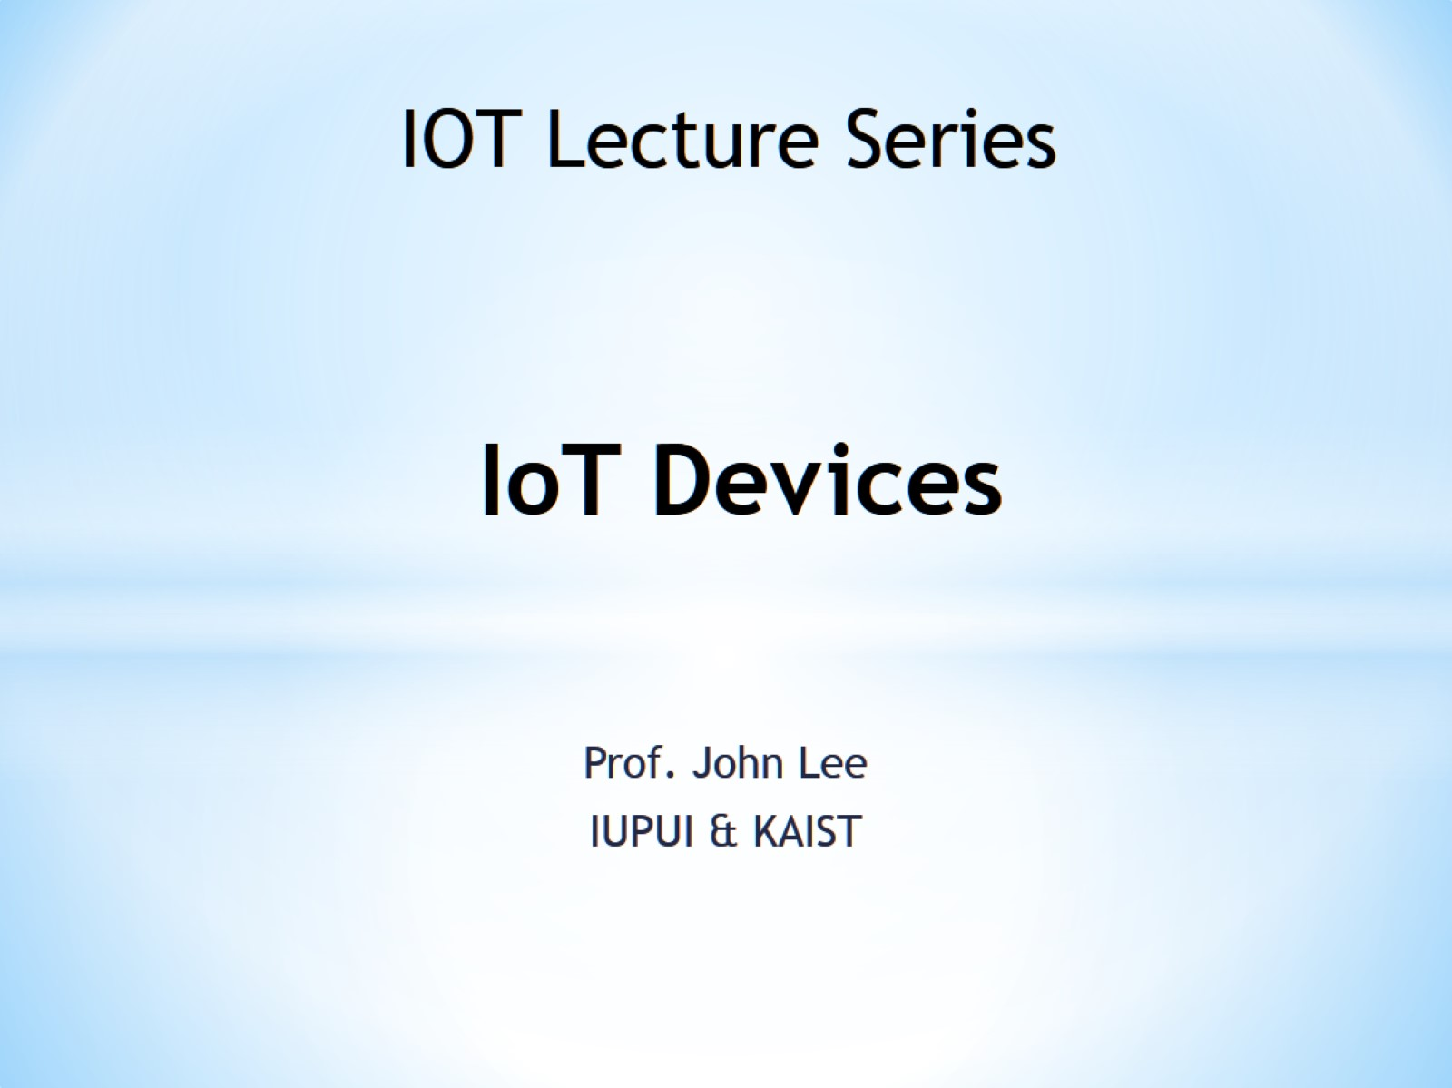
IoT Devices

Slide 2
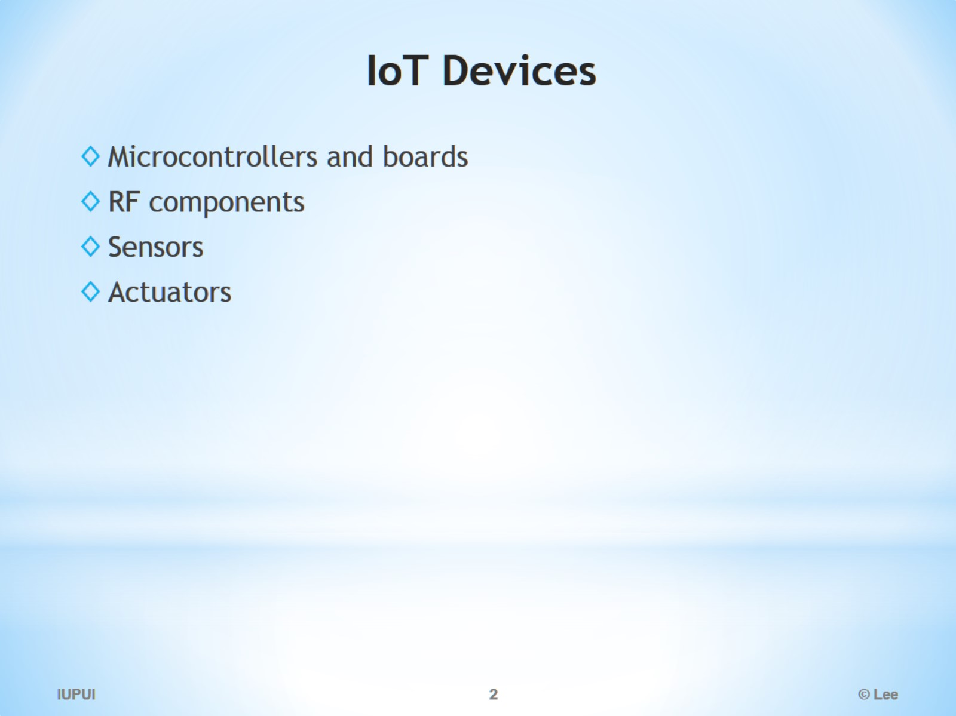
IoT Devices

Slide 3
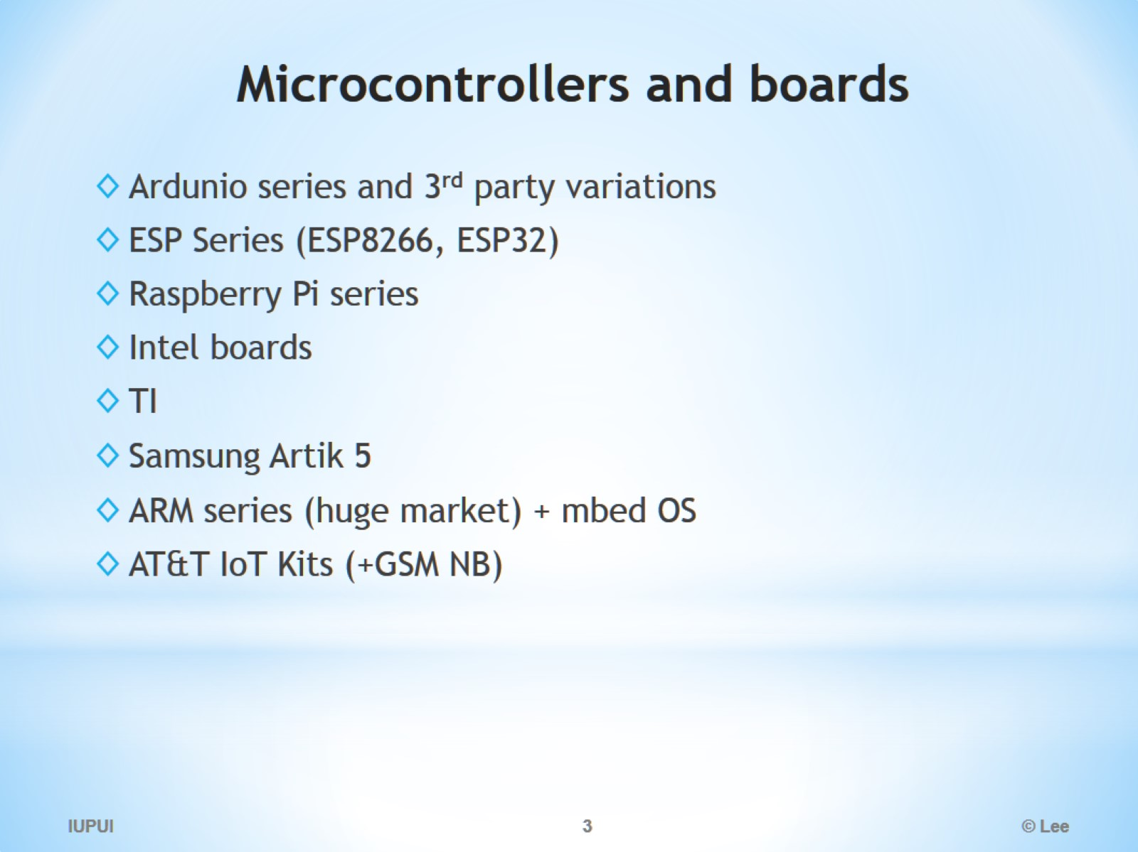
Microcontrollers and boards

Slide 4
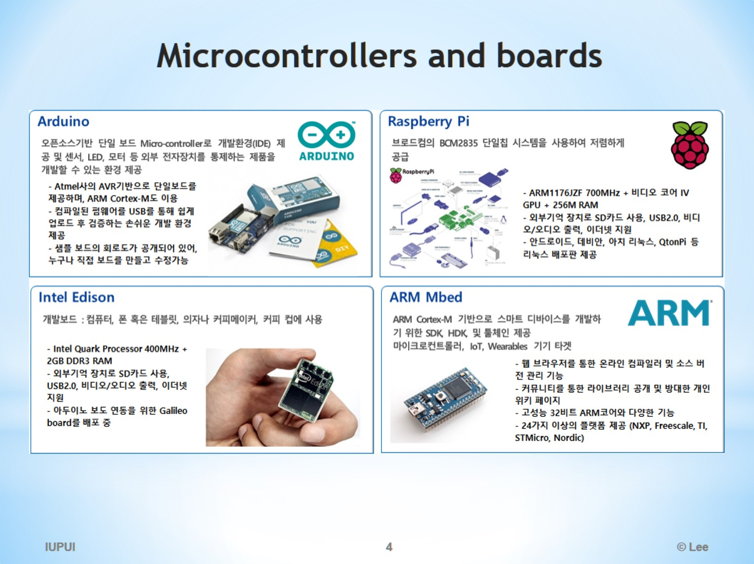
Microcontrollers and boards

Slide 5
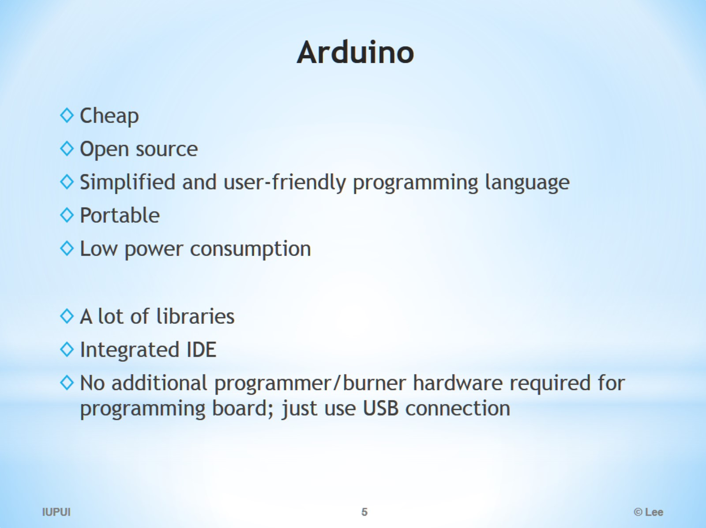
Arduino

Slide 6
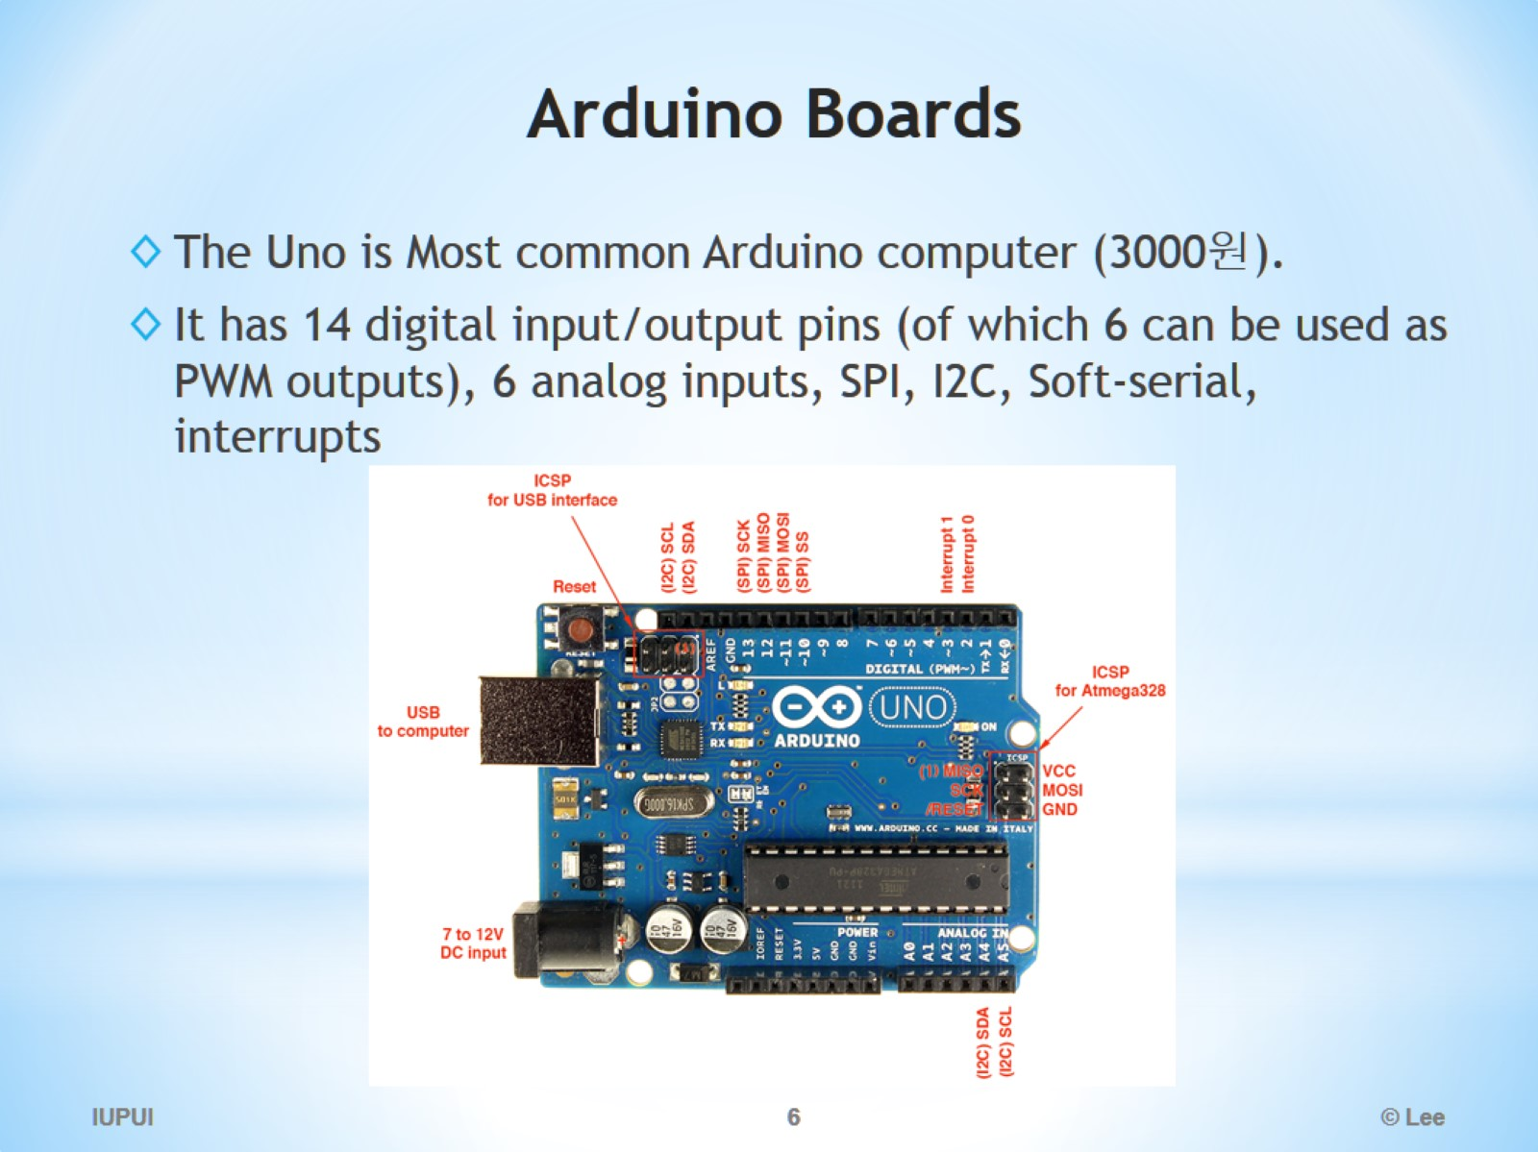
Arduino Boards

Slide 7
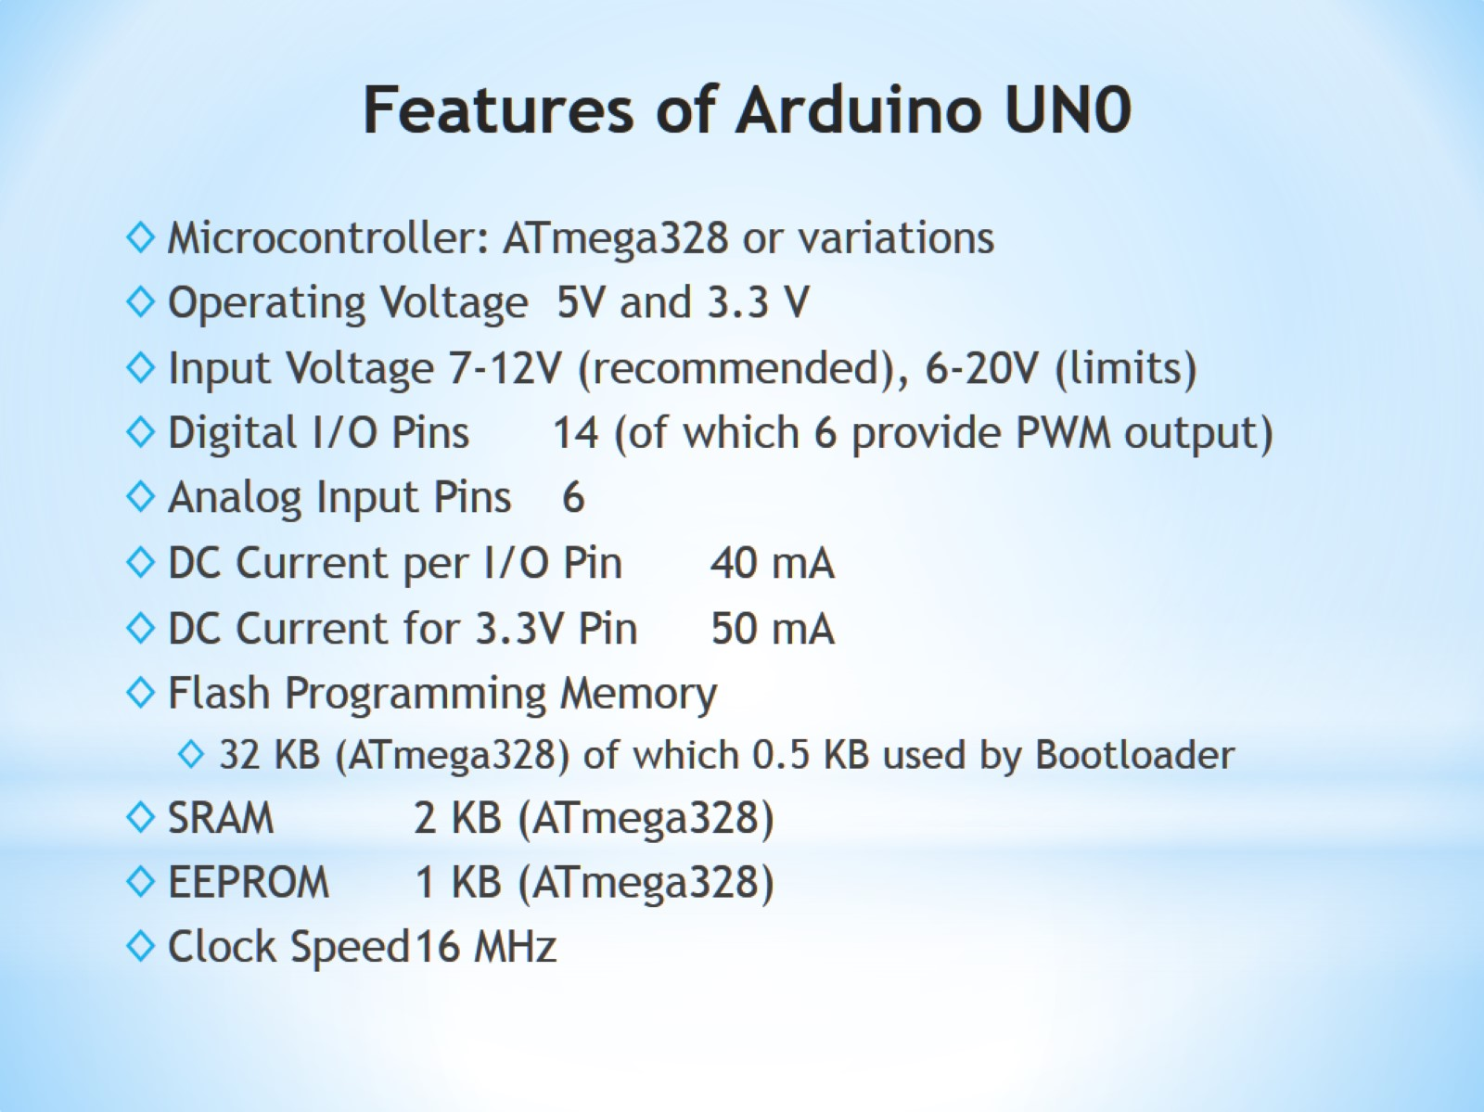
Features of Arduino UN0

Slide 8
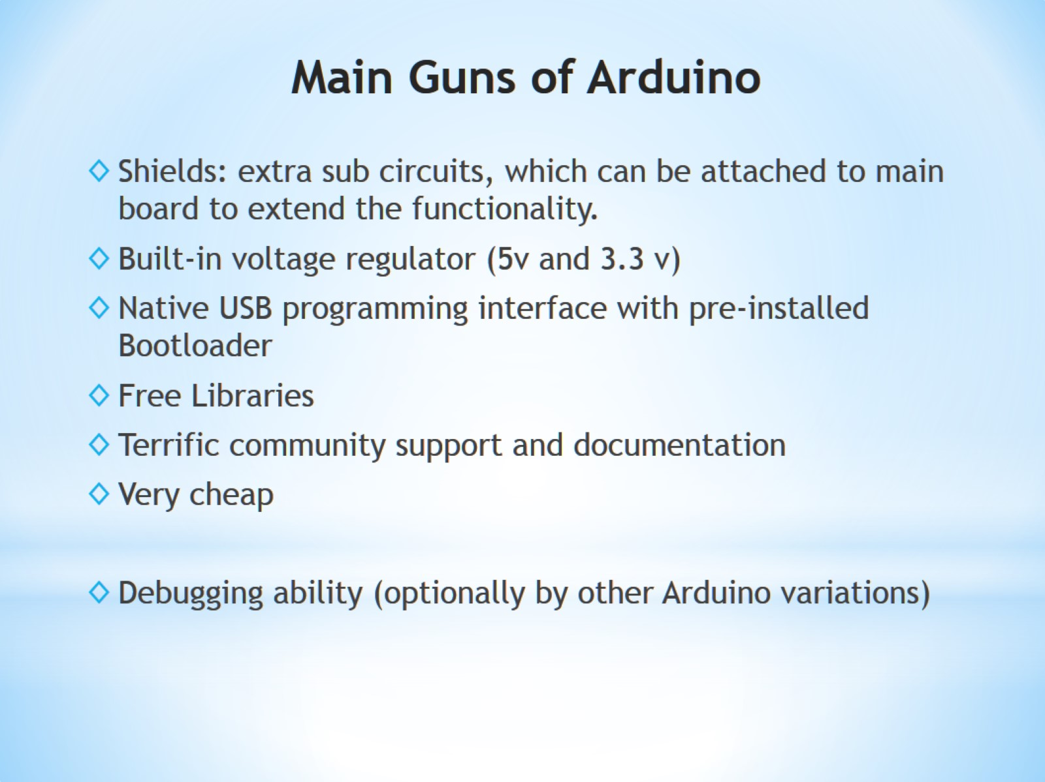
Main Guns of Arduino

Slide 9
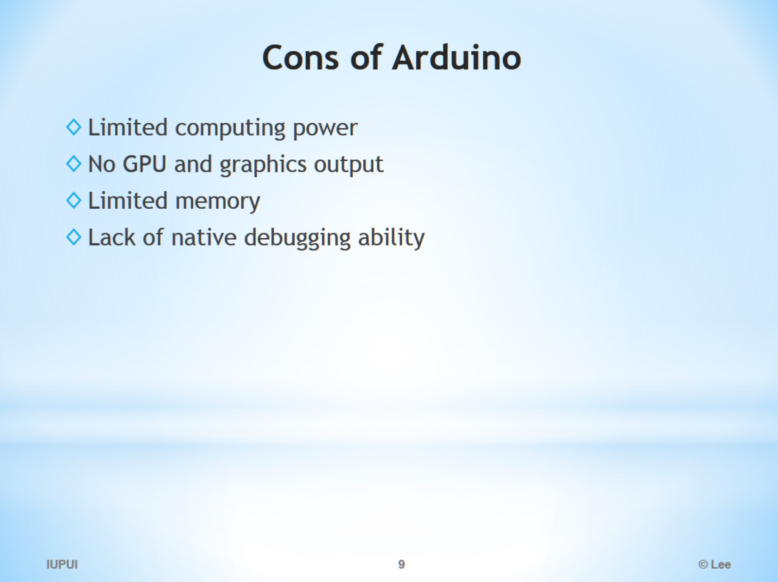
Cons of Arduino

Slide 10
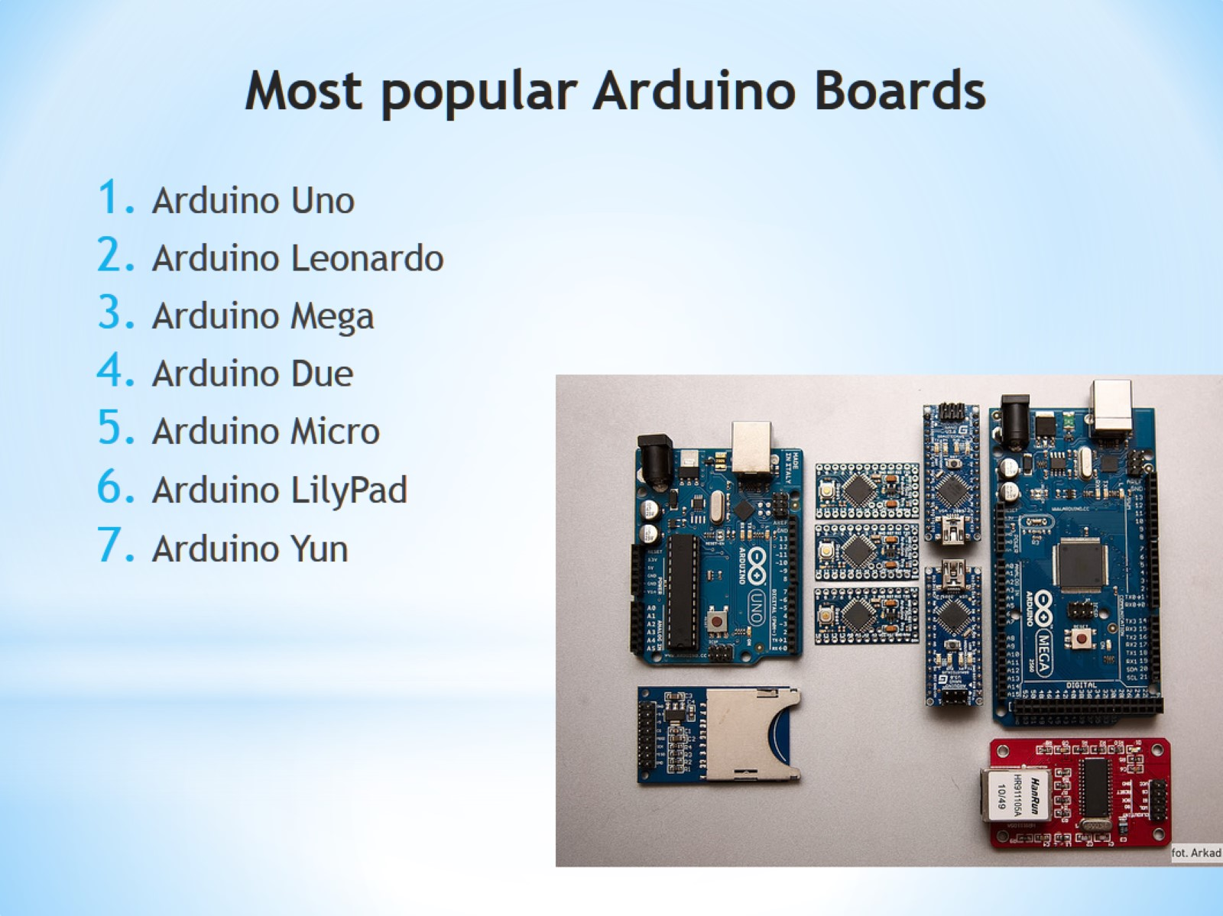
Most popular Arduino Boards

Slide 11
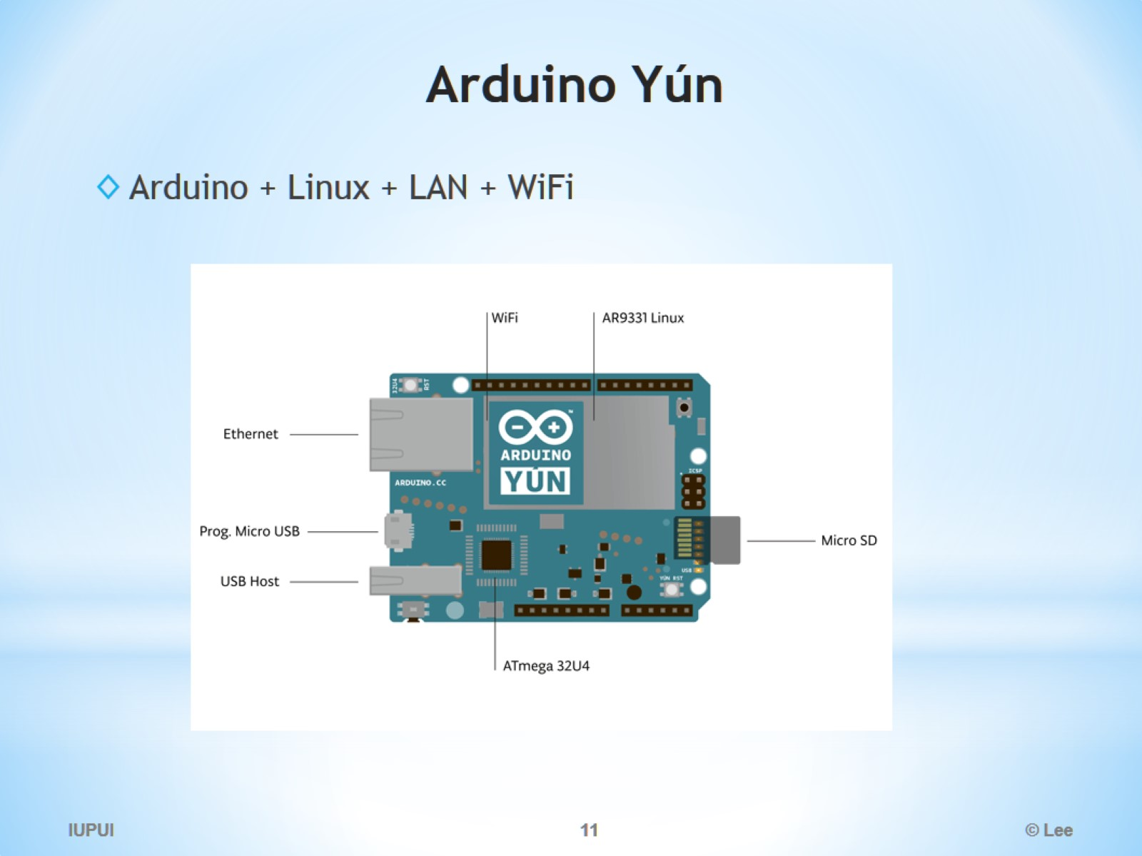
Arduino Yún

Slide 12
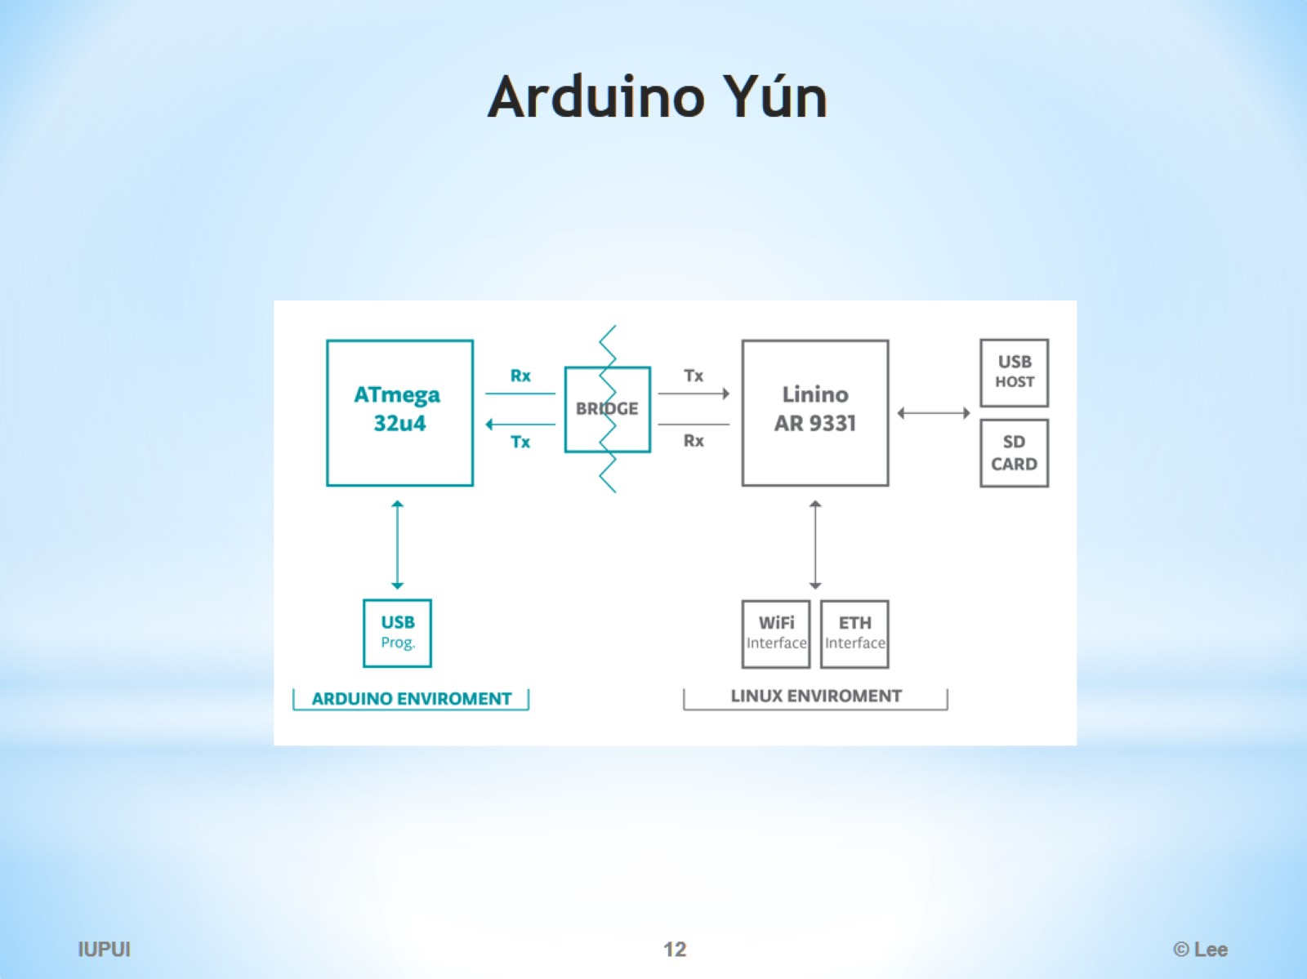
Arduino Yún

Slide 13
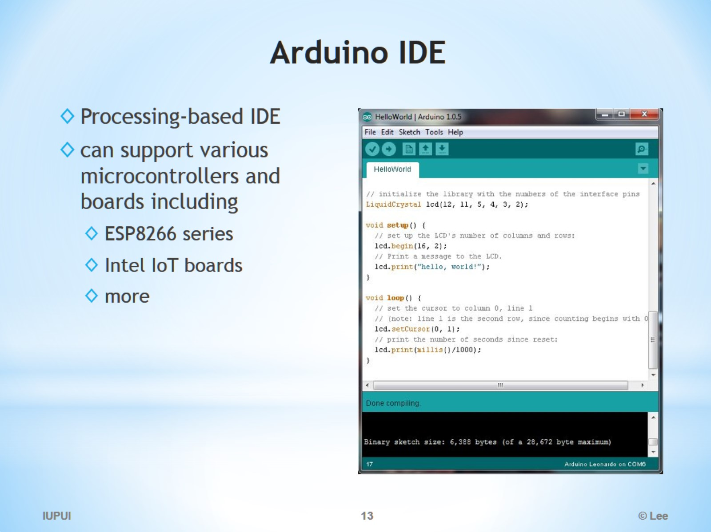
Arduino IDE

Slide 14
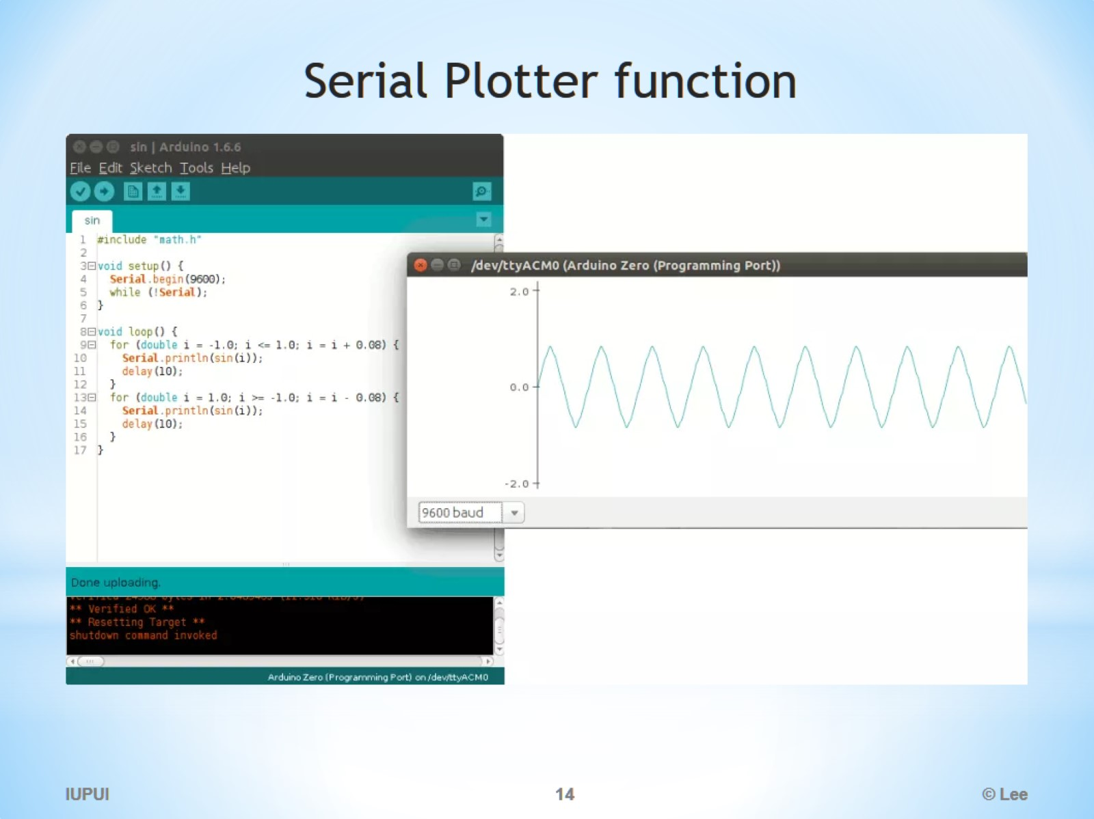
Serial Plotter function

Slide 15

Where to learn Arduino ?

Slide 16
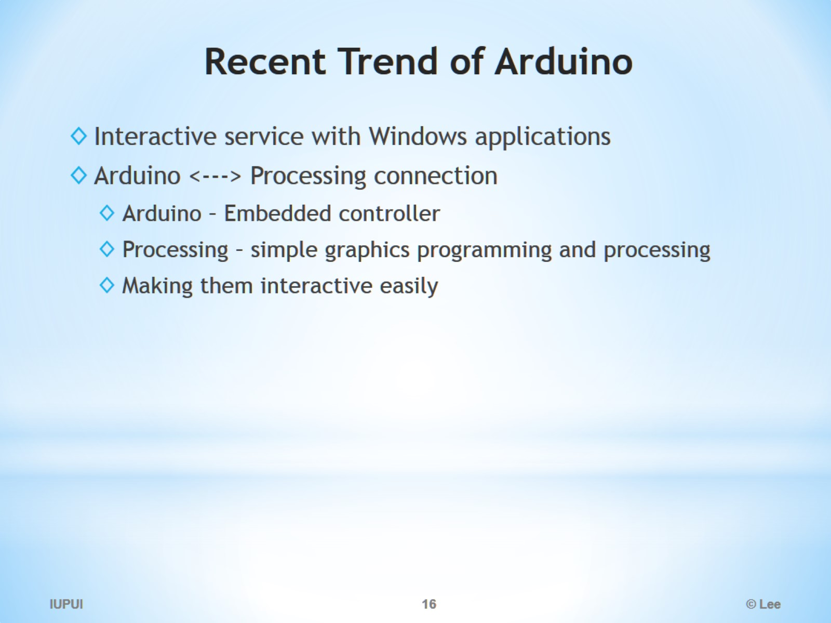
Recent Trend of Arduino

Slide 17
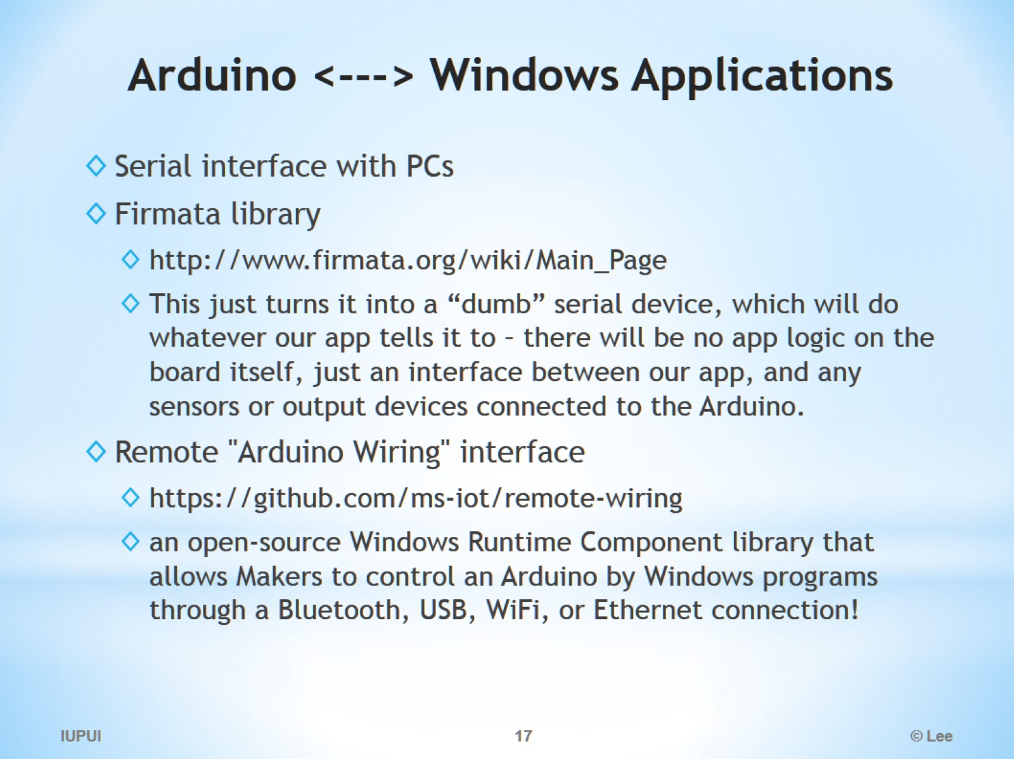
Arduino <---> Windows Applications

Slide 18
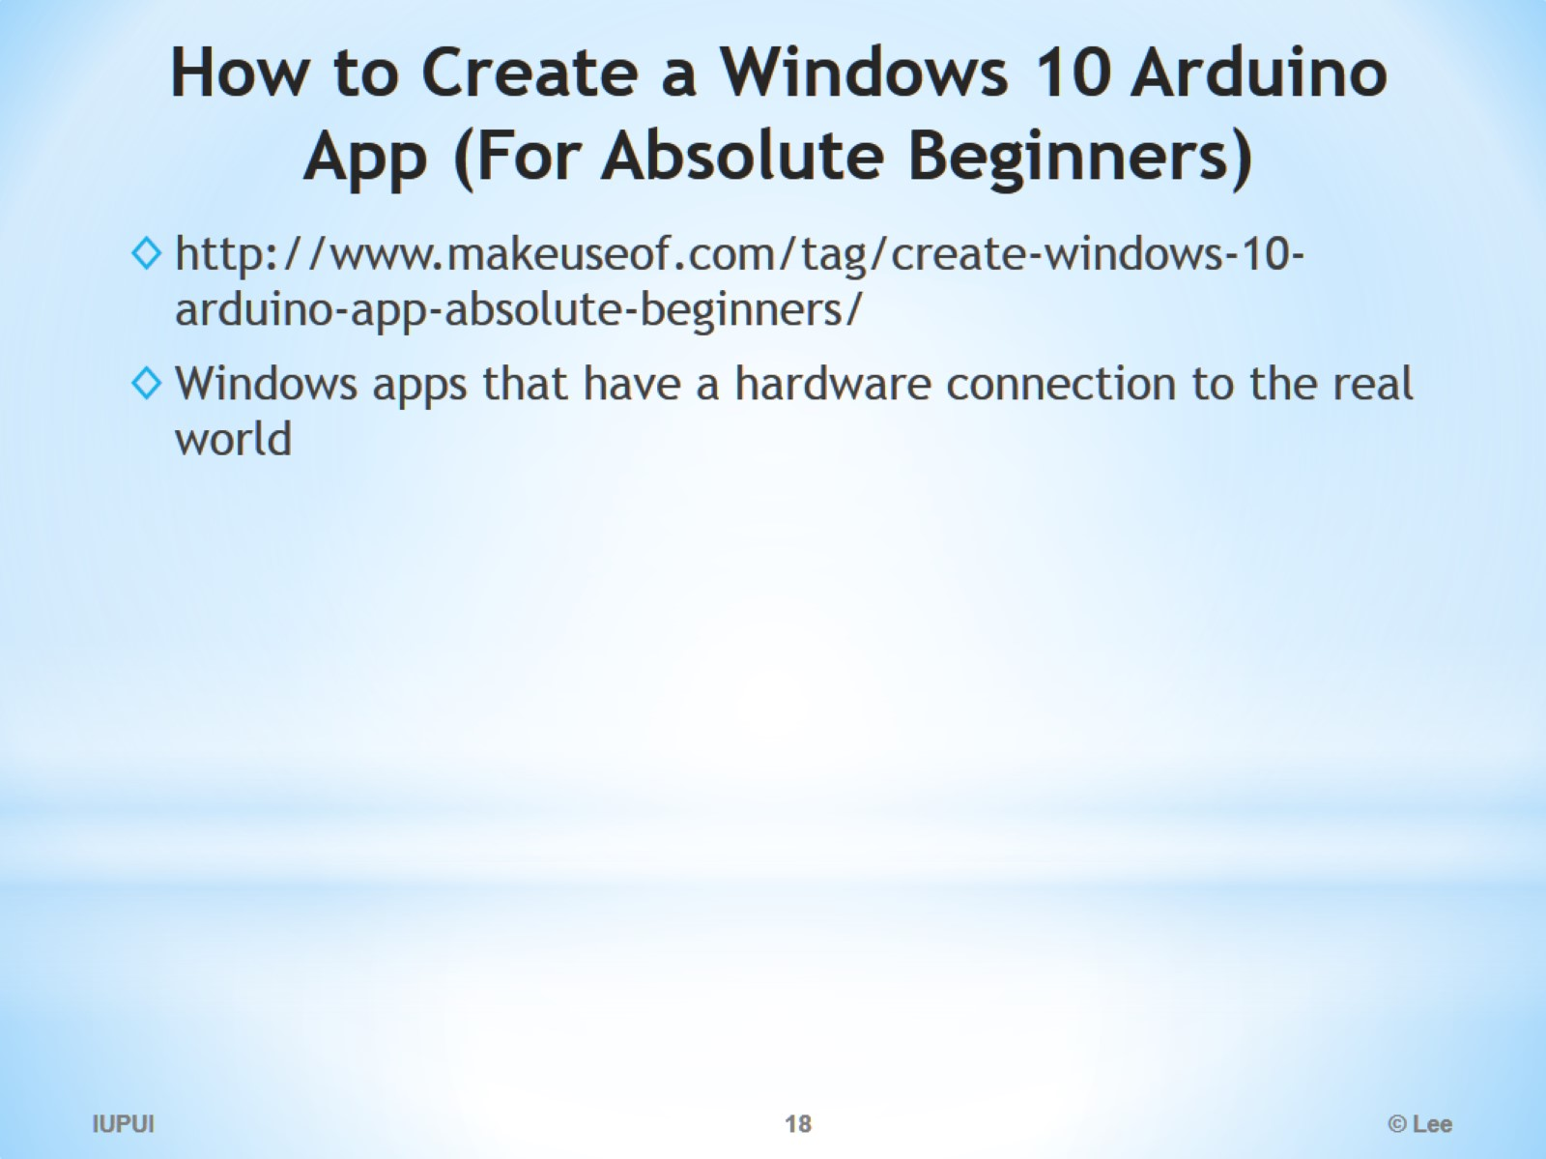
How to Create a Windows 10 Arduino App (For Absolute Beginners)

Slide 19
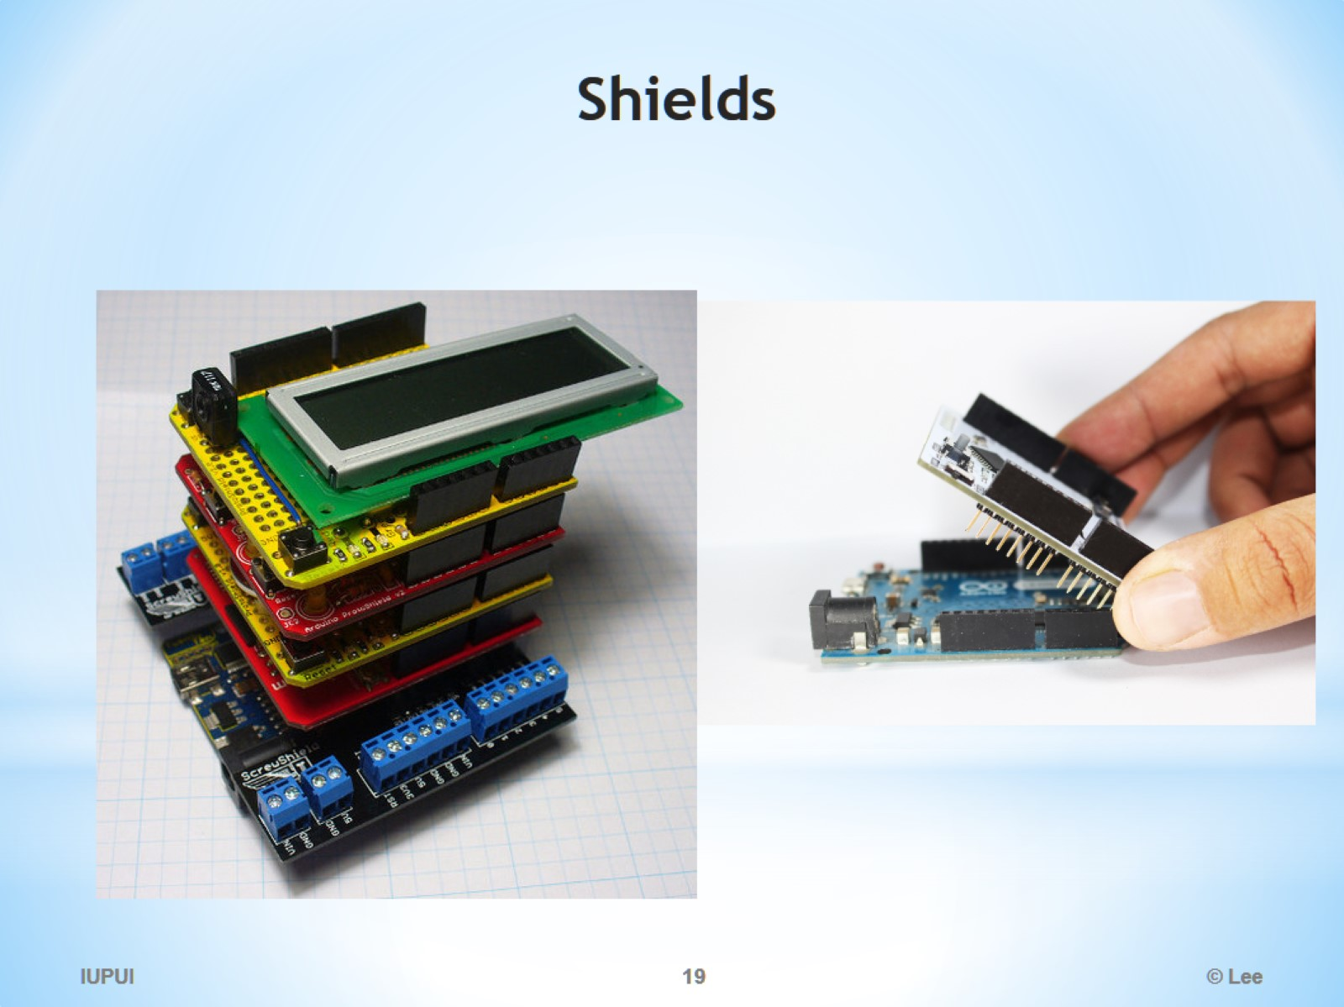
Shields

Slide 20
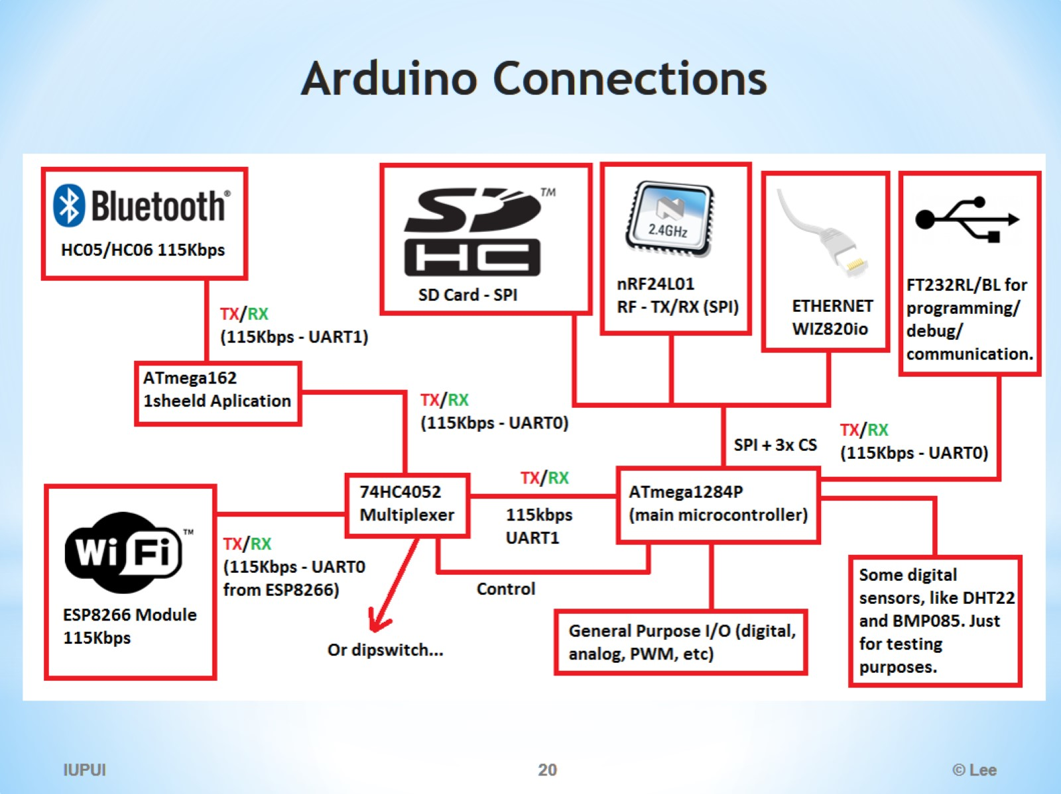
Arduino Connections

Slide 21
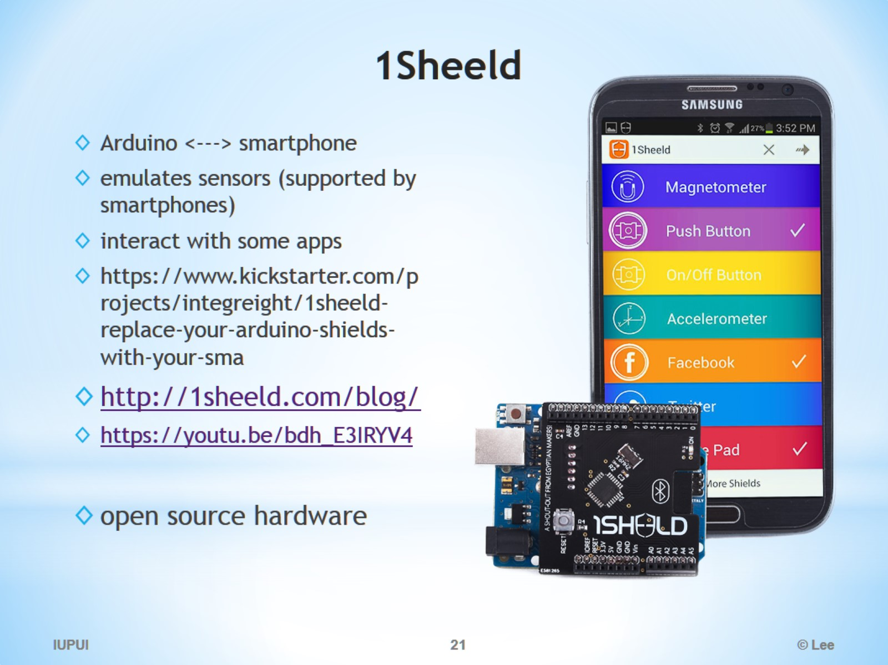
1Sheeld

Slide 22
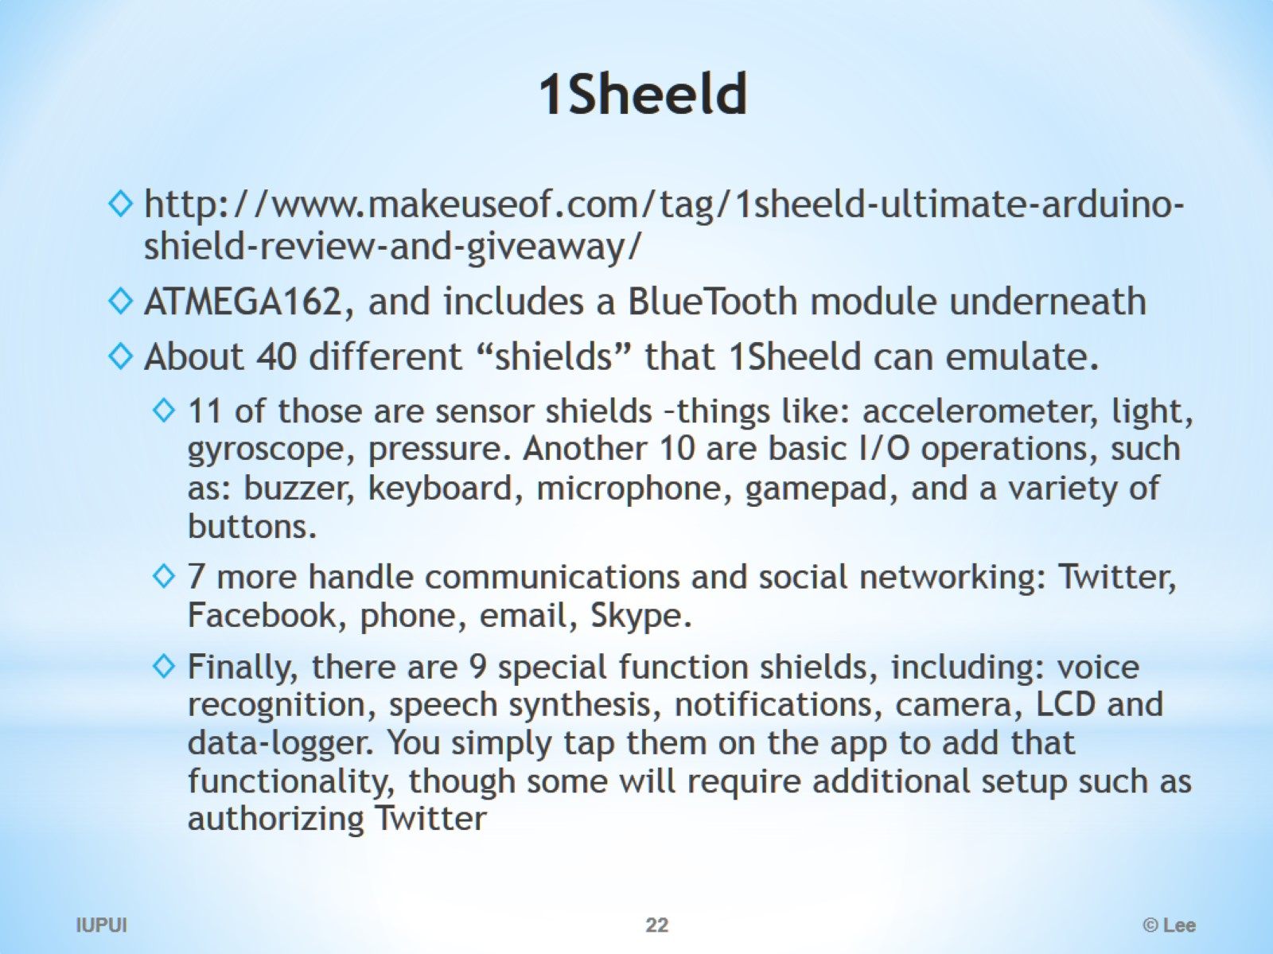
1Sheeld

Slide 23
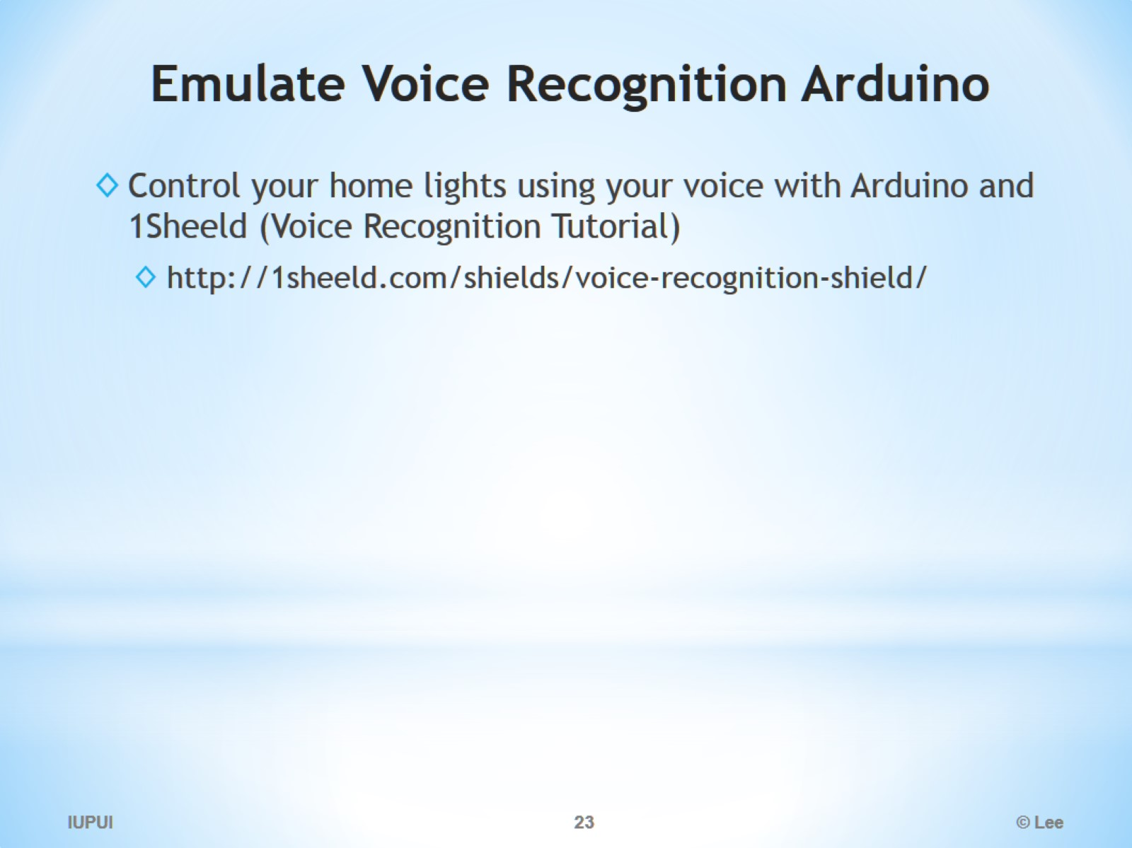
Emulate Voice Recognition Arduino

Slide 24
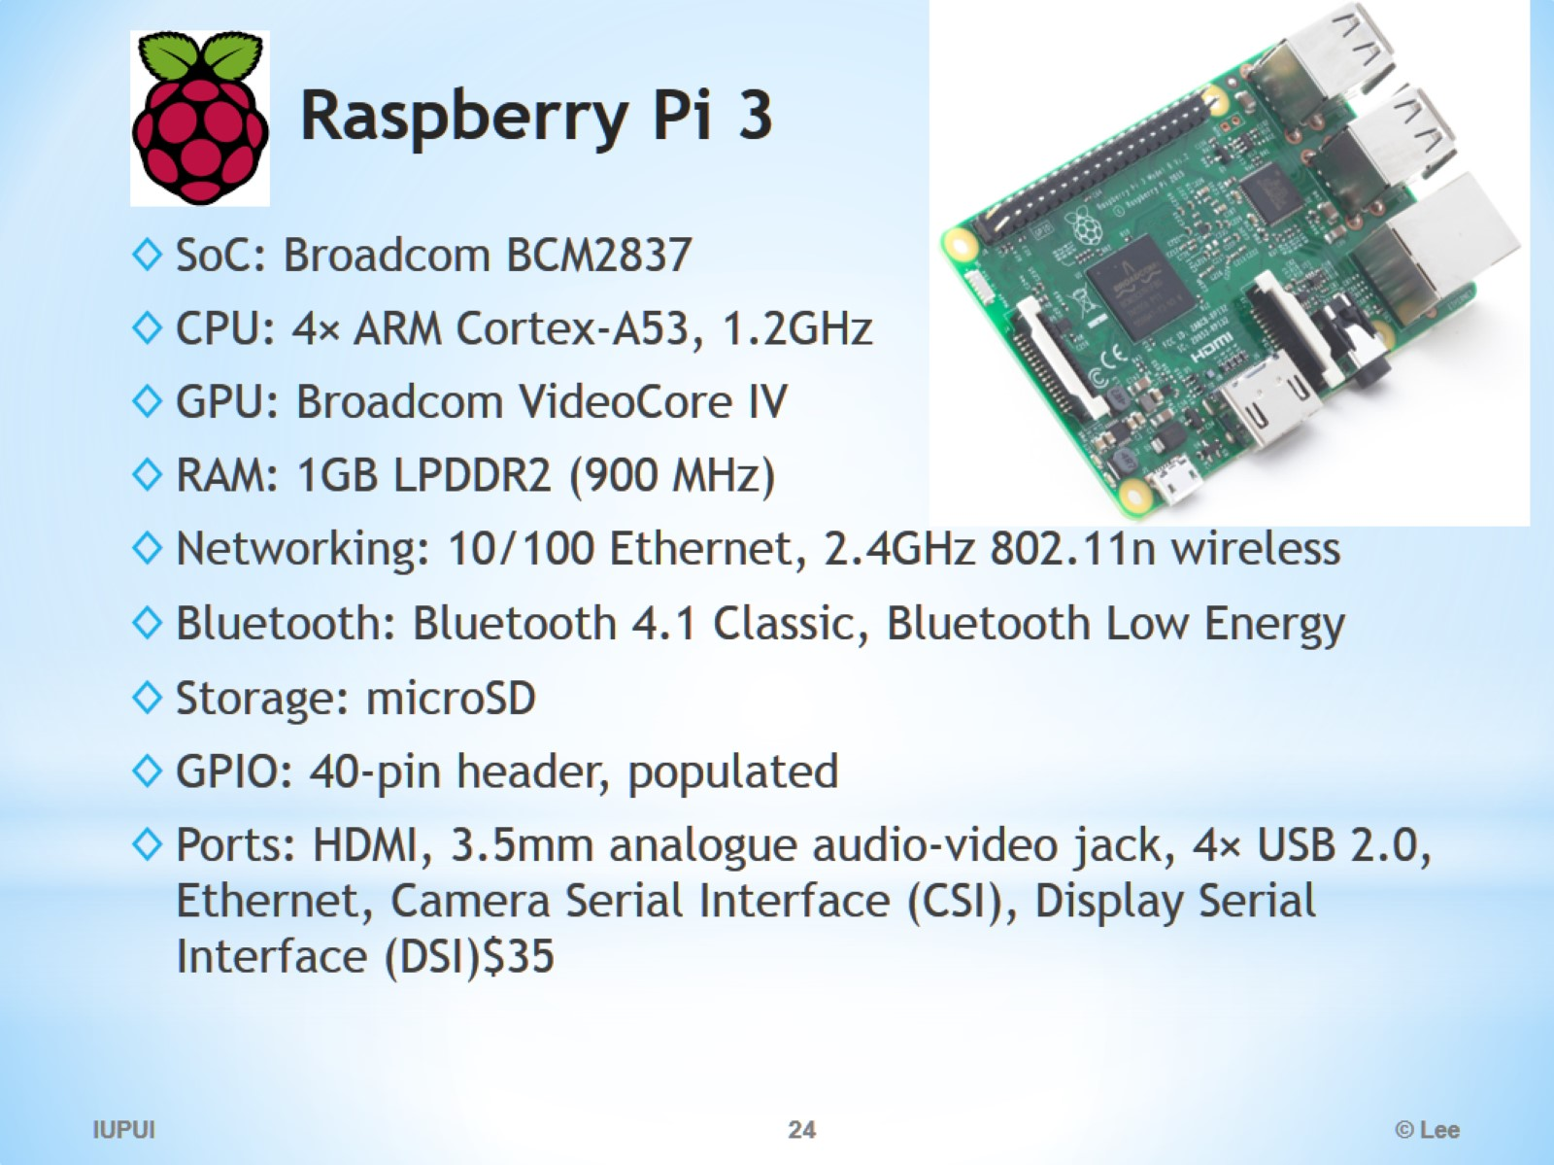
Raspberry Pi 3

Slide 25
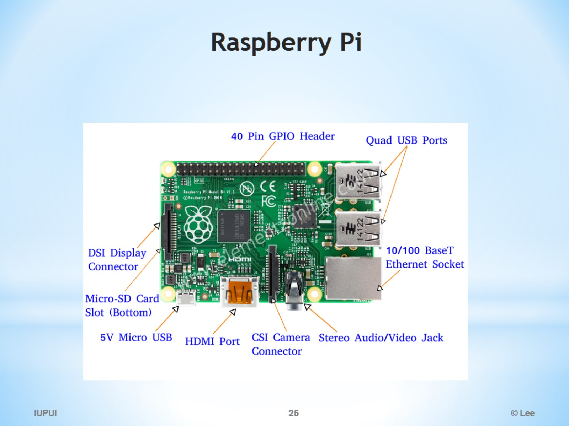
Raspberry Pi

Slide 26
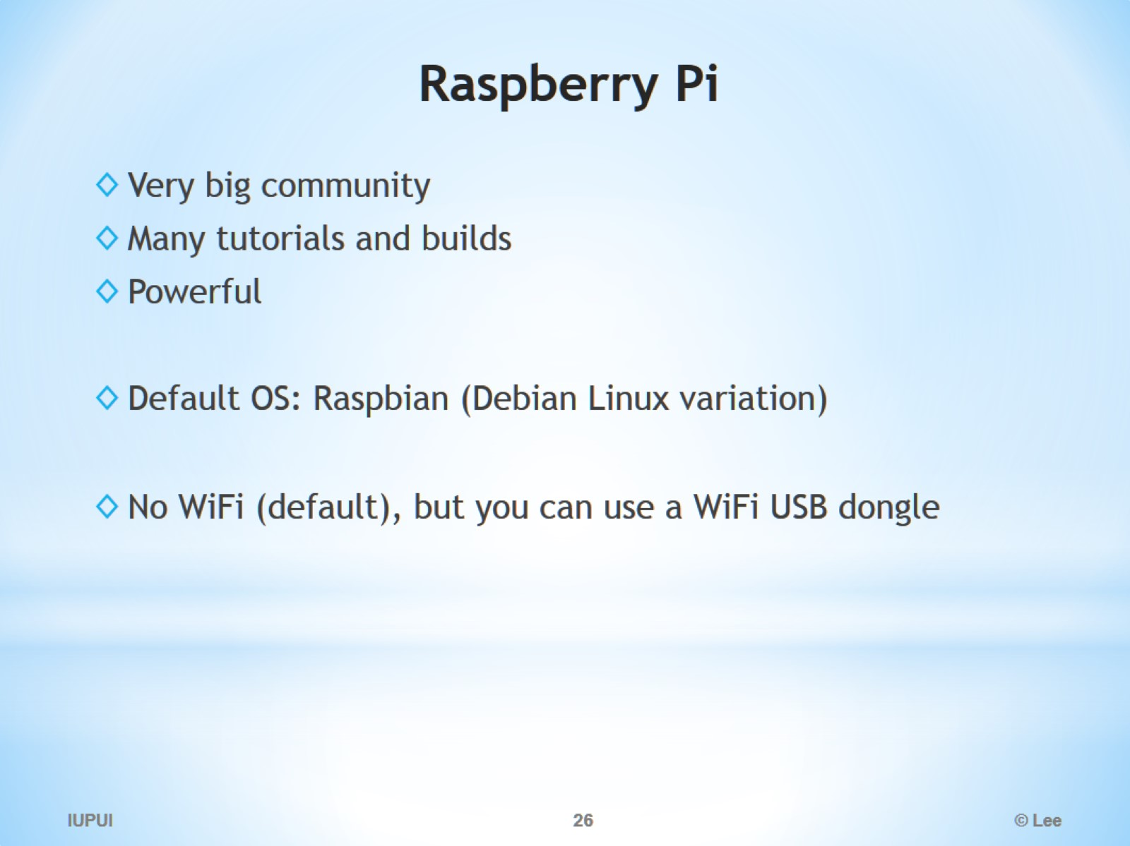
Raspberry Pi

Slide 27
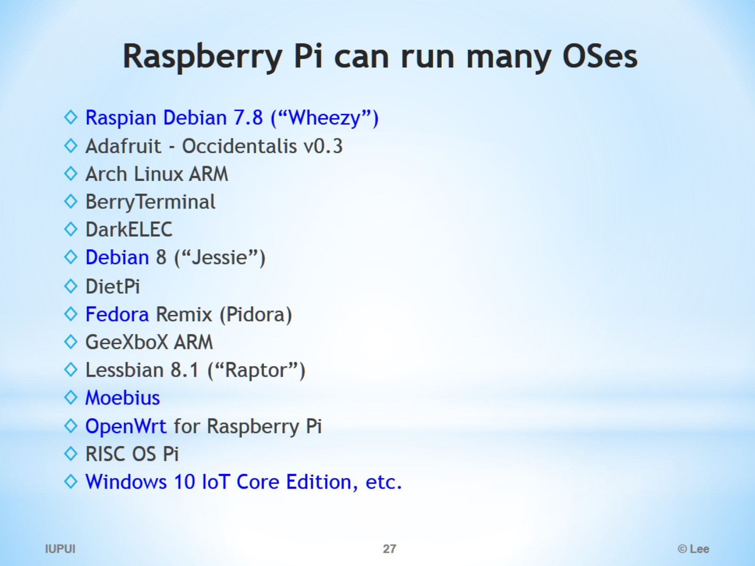
Raspberry Pi can run many OSes

Slide 28
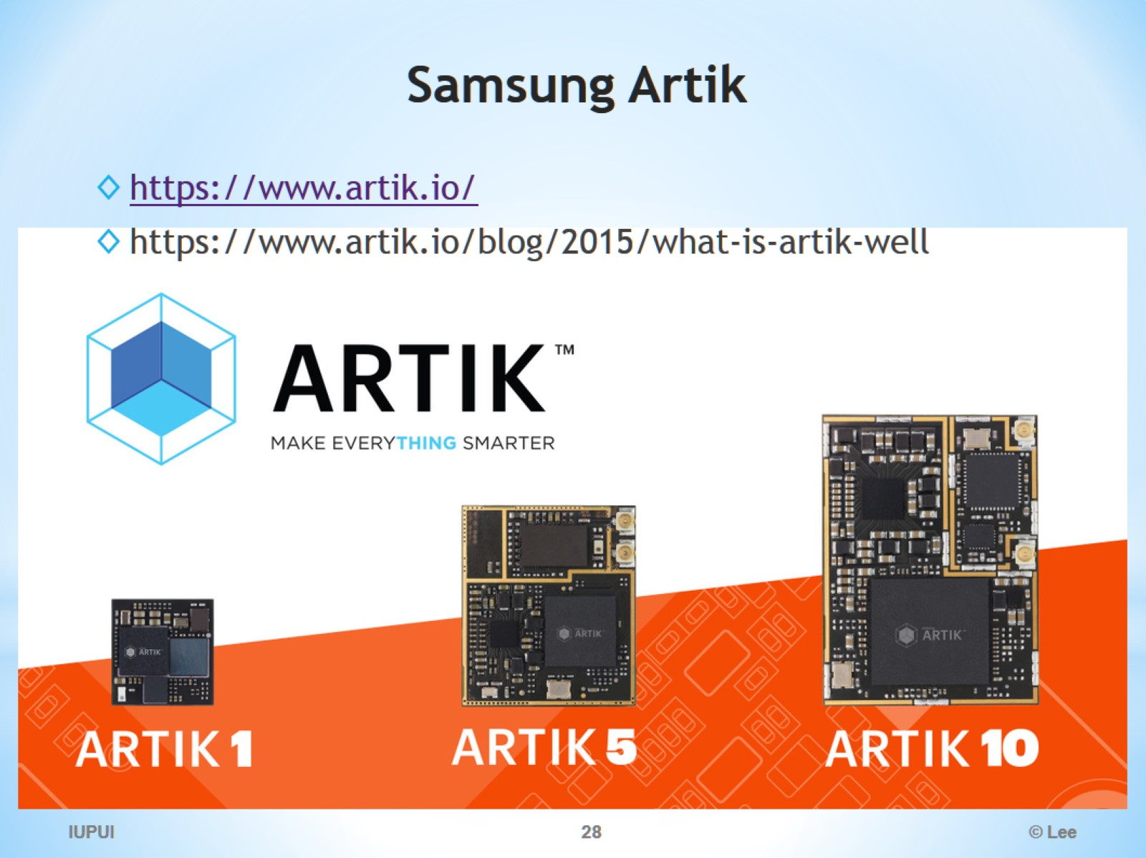
Samsung Artik

Slide 29
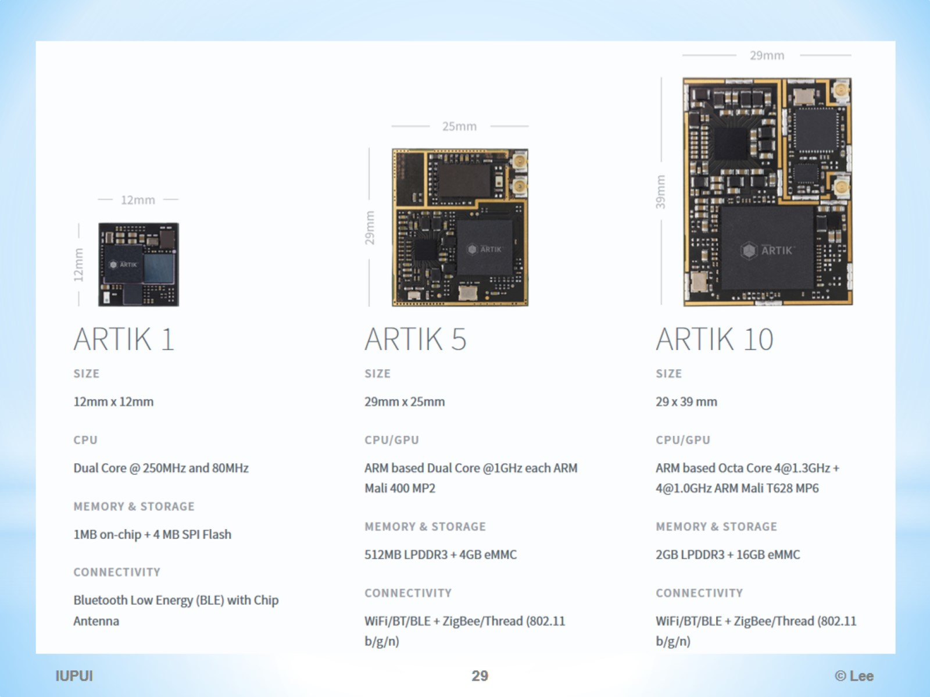

Slide 30
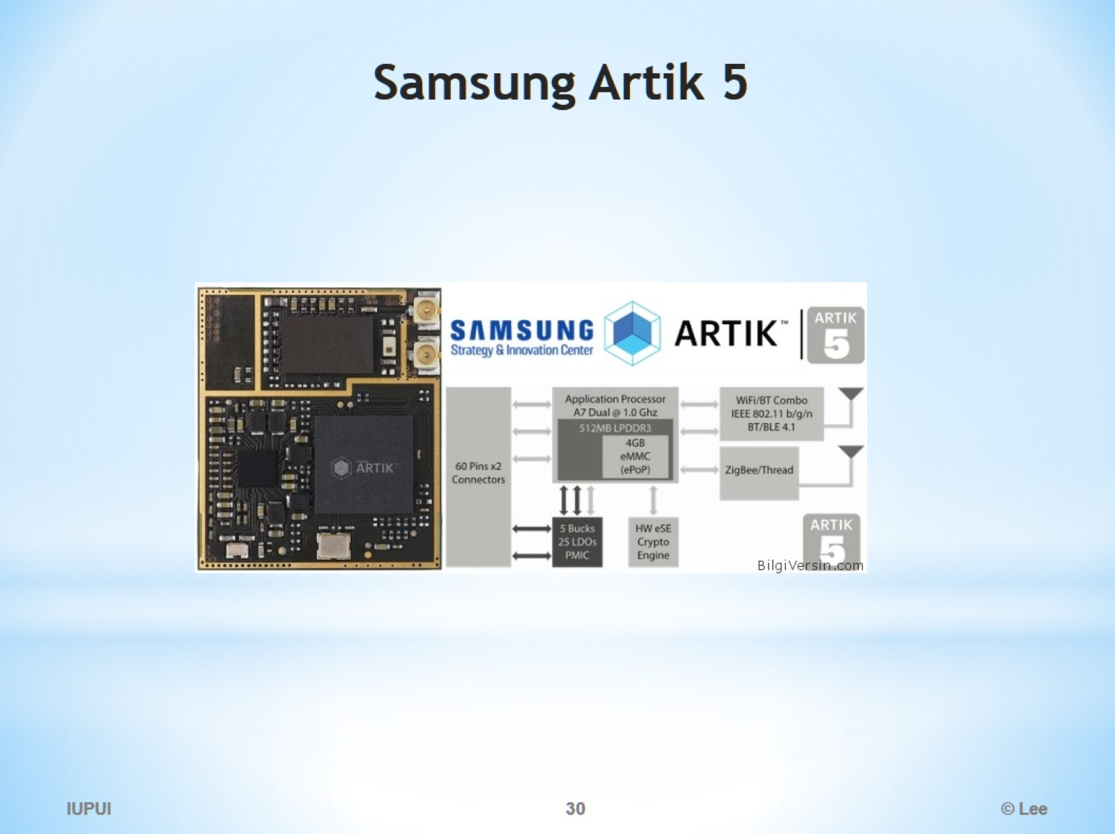
Samsung Artik 5

Slide 31
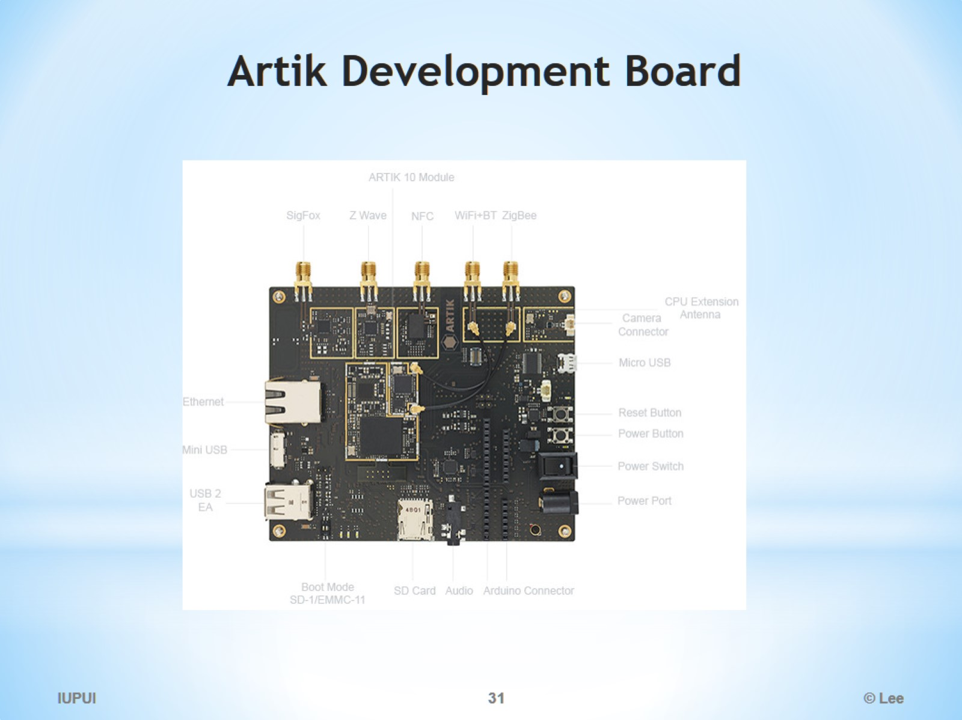
Artik Development Board

Slide 32
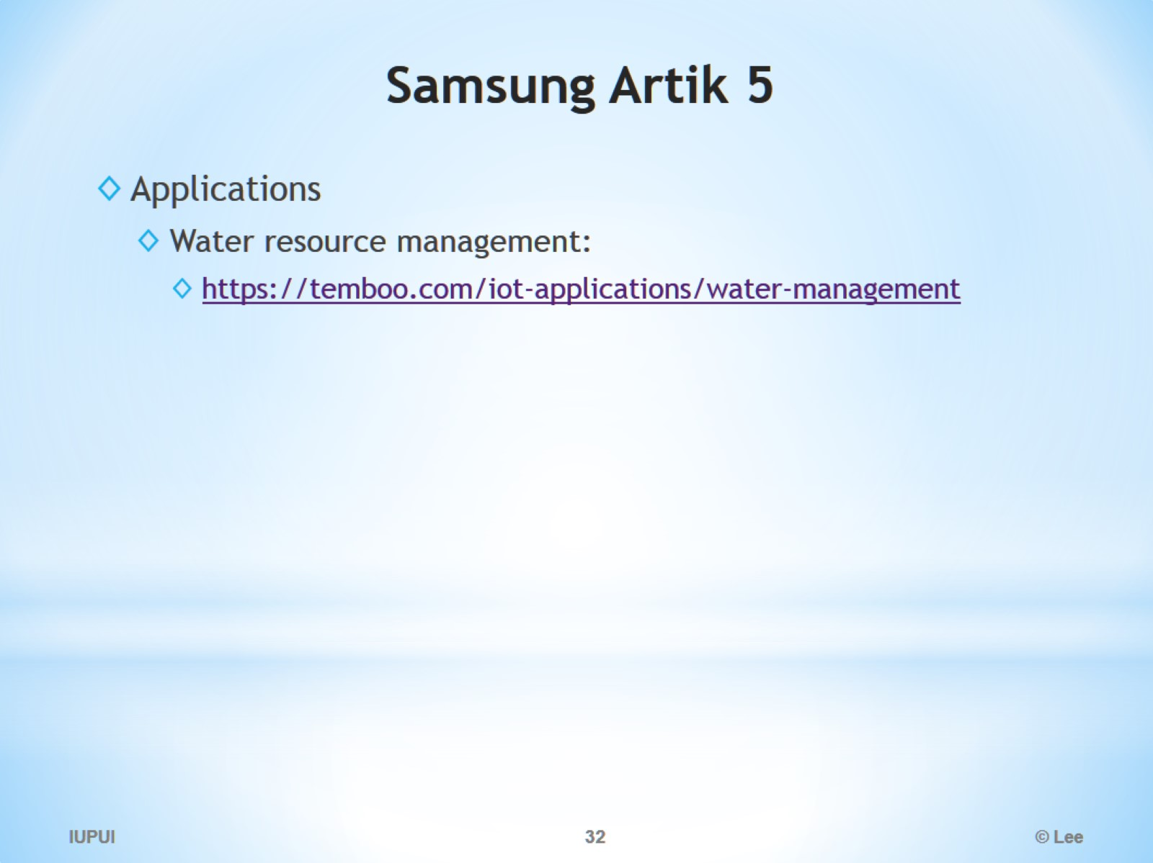
Samsung Artik 5

Slide 33
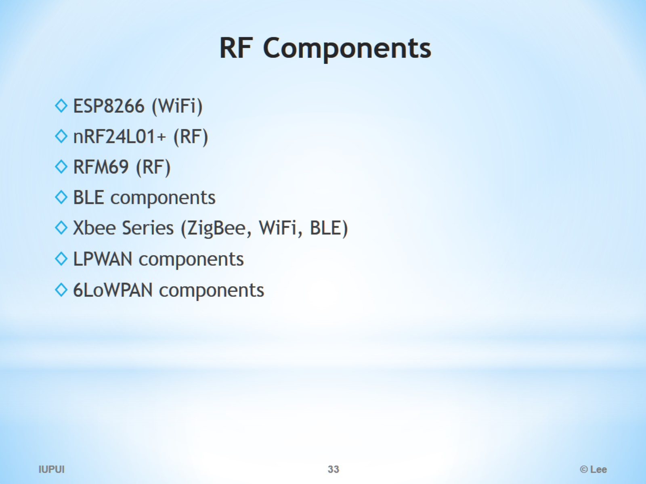
RF Components

Slide 34
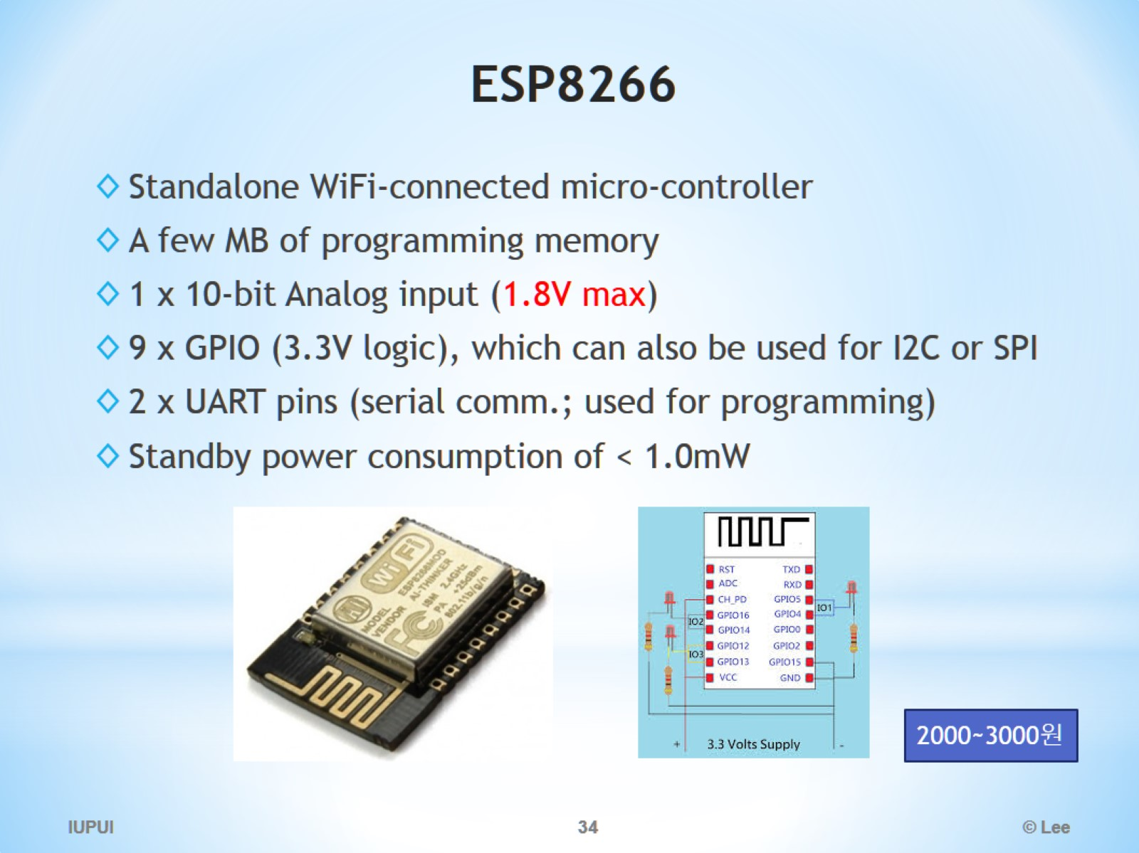
ESP8266

Slide 35
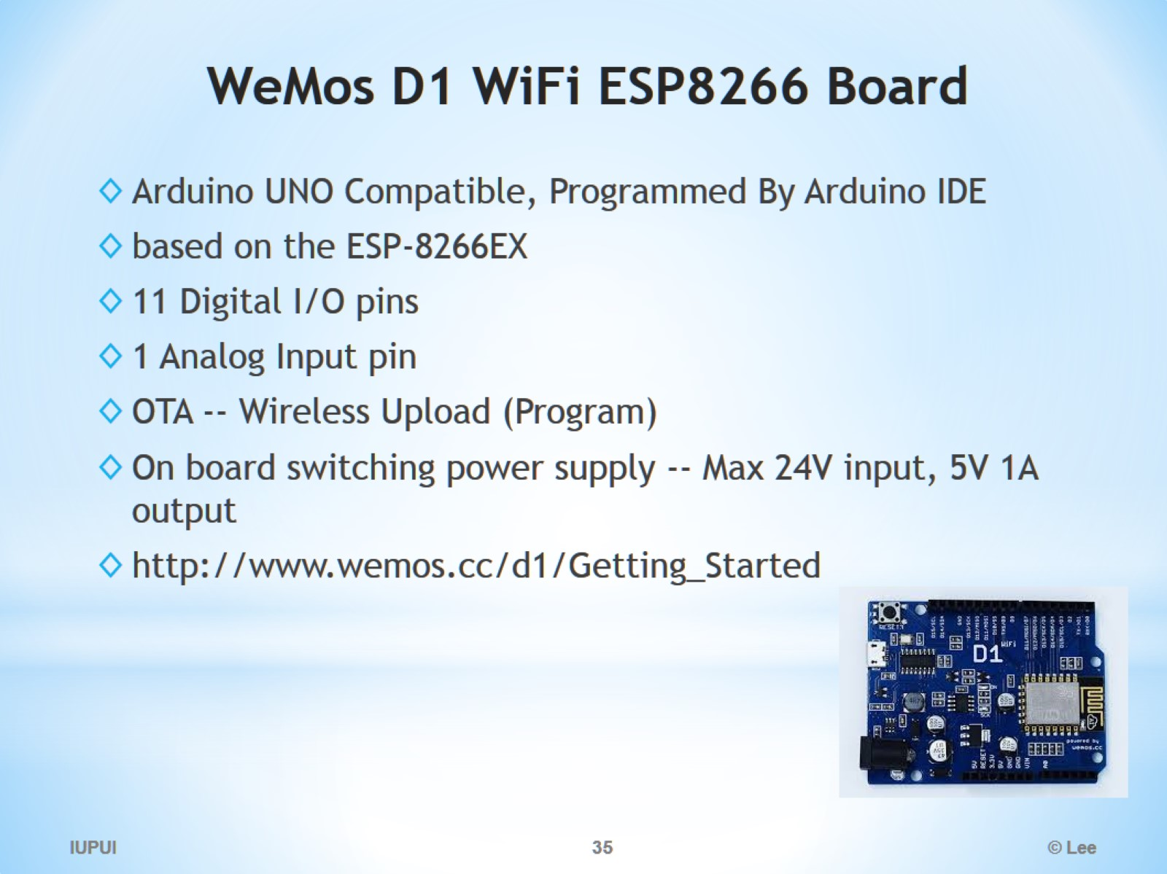
WeMos D1 WiFi ESP8266 Board

Slide 36
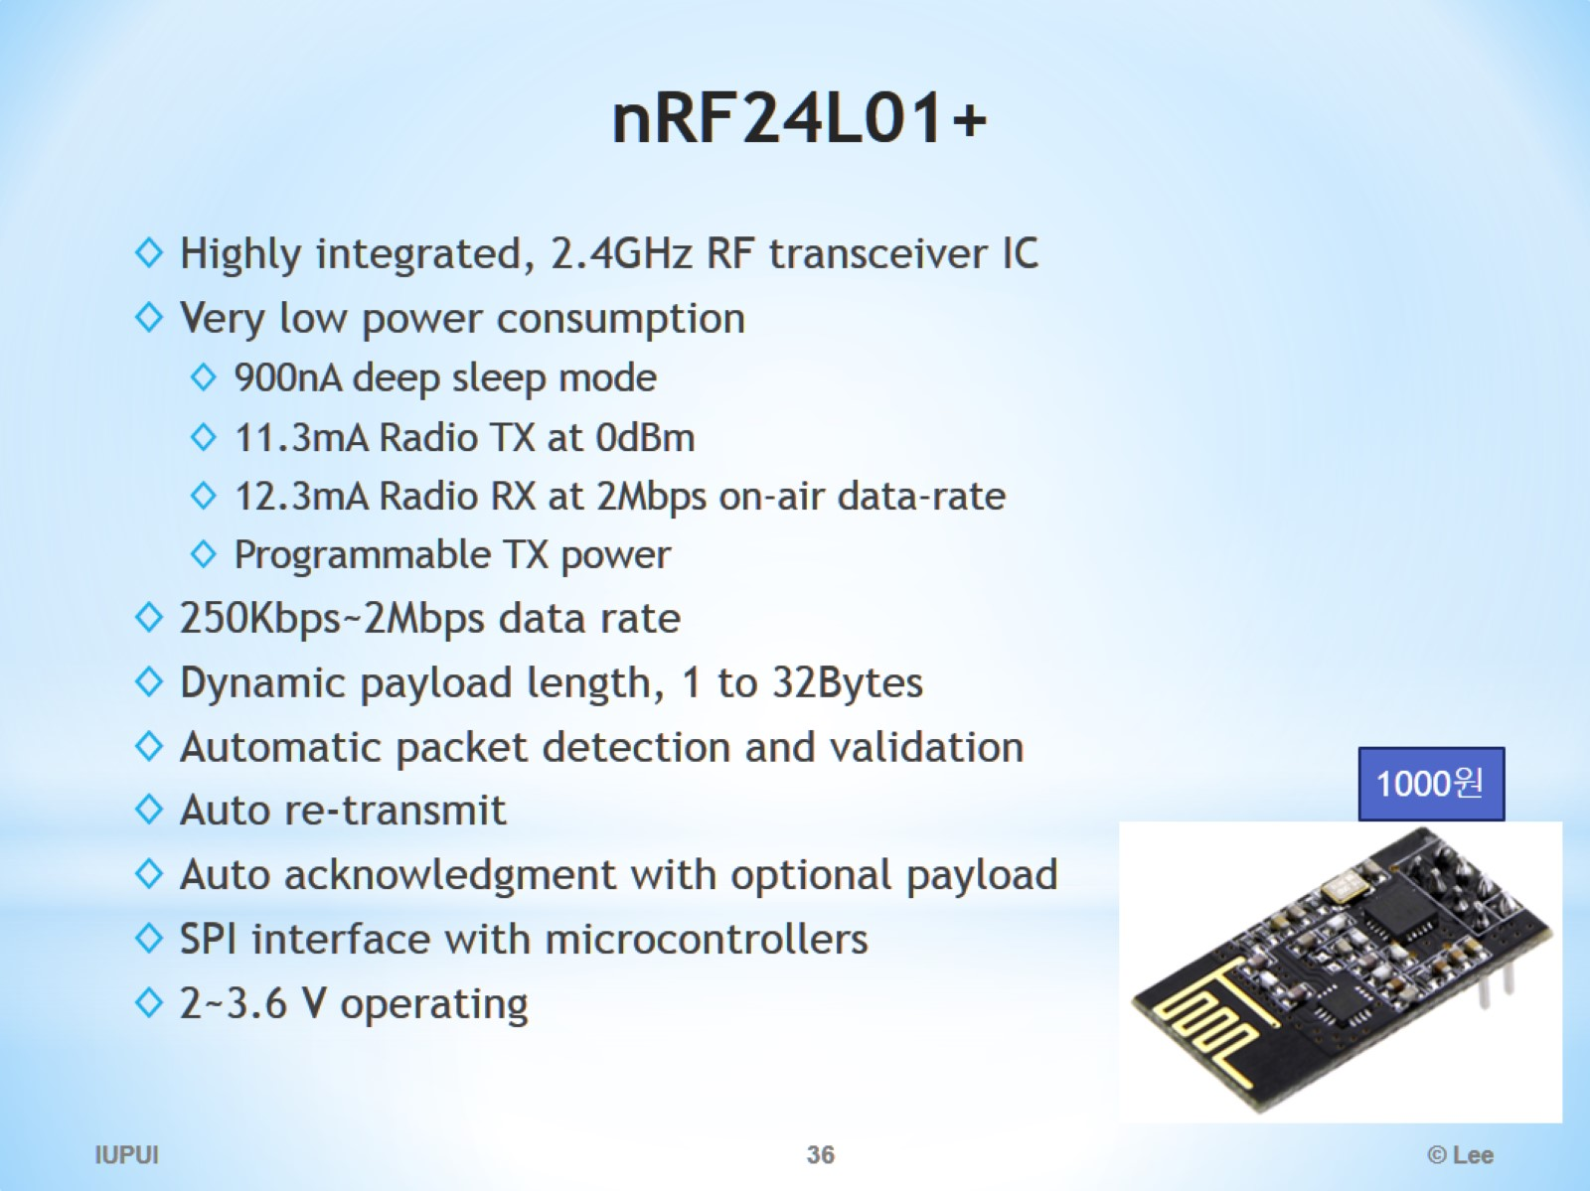
nRF24L01+

Slide 37
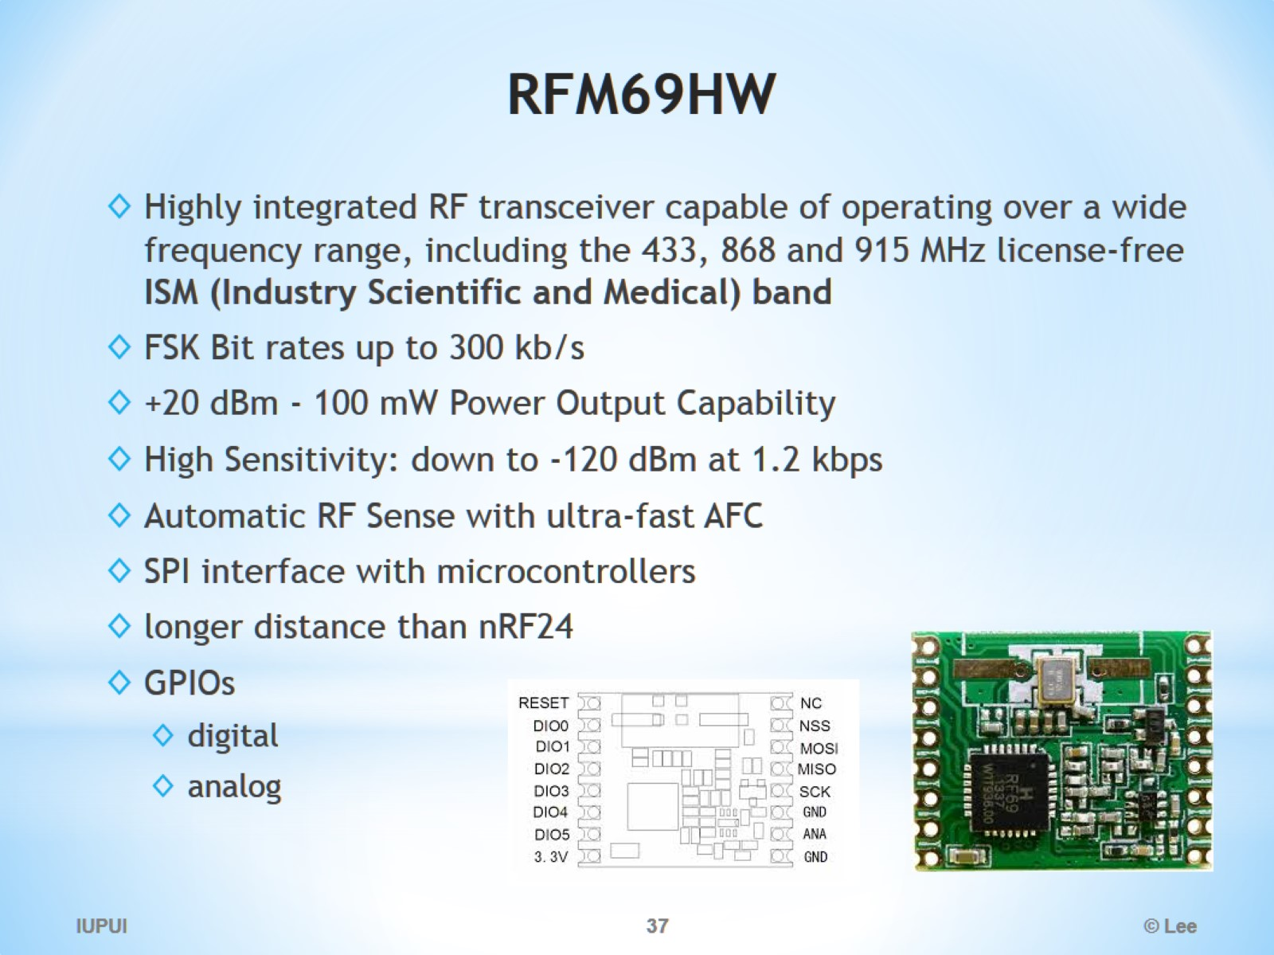
RFM69HW

Slide 38
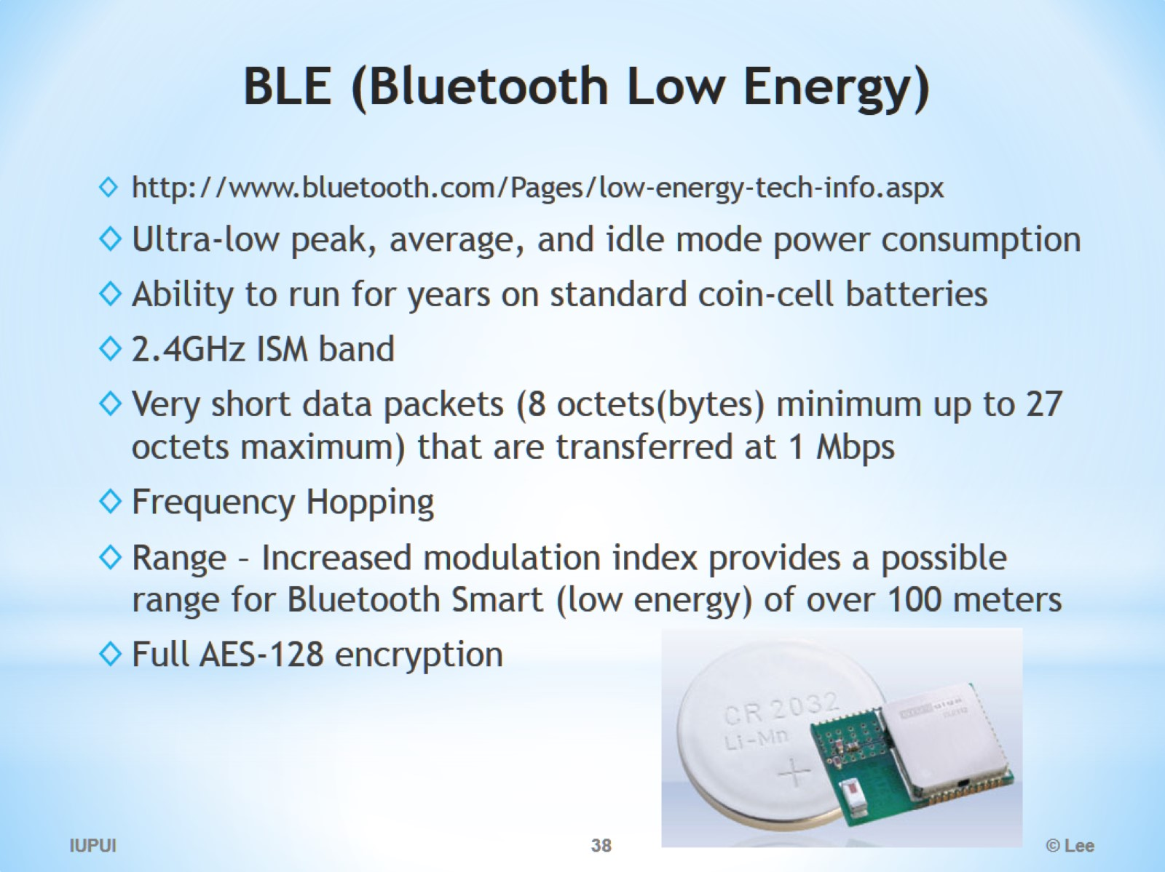
BLE (Bluetooth Low Energy)

Slide 39
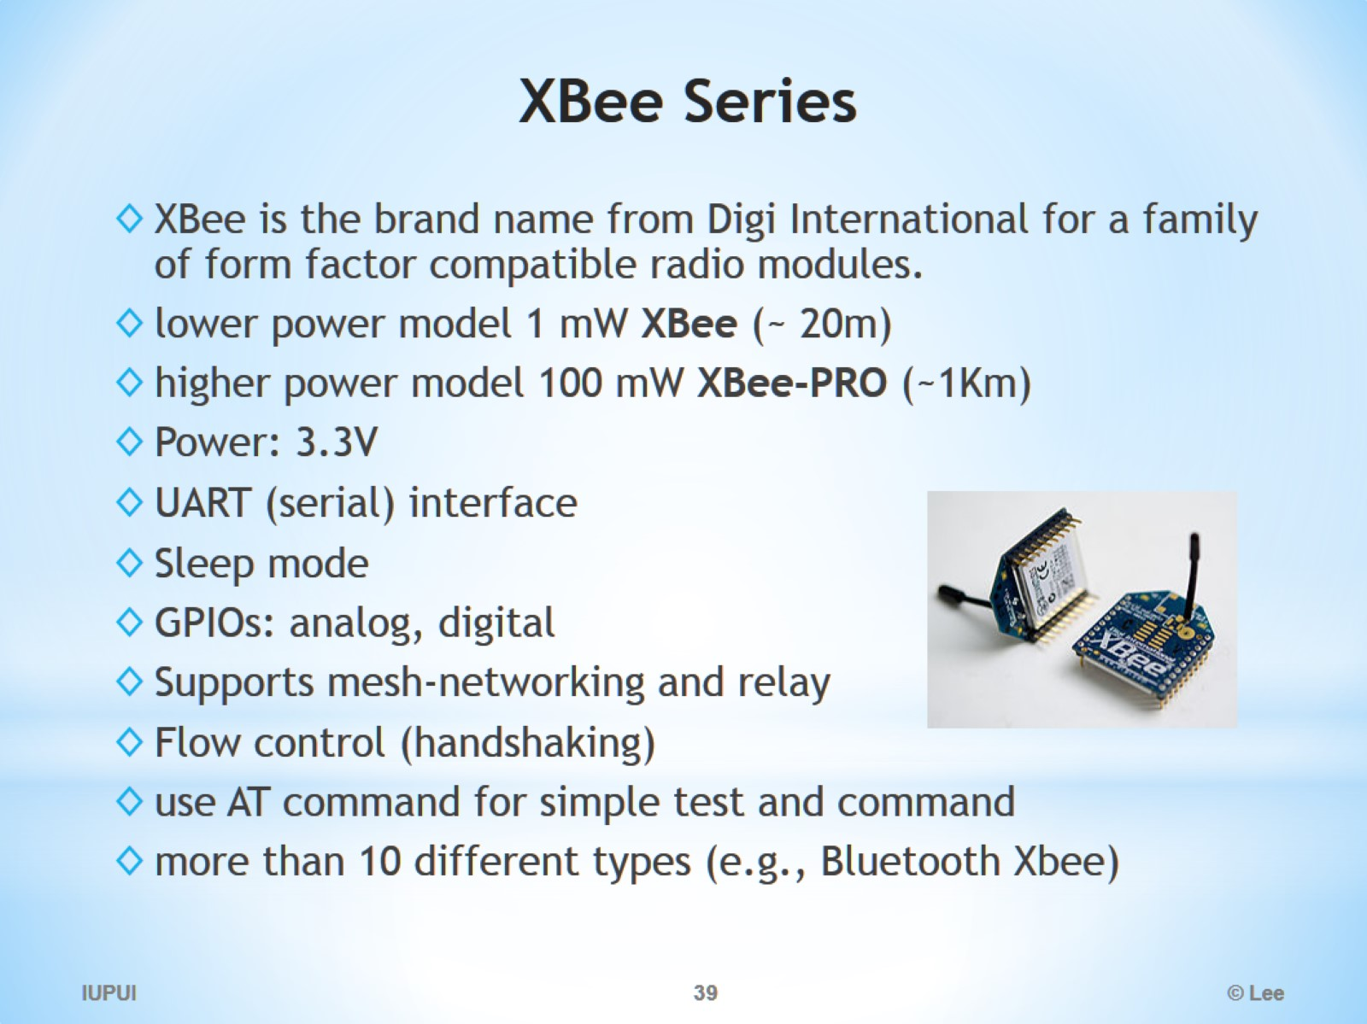
XBee Series

Slide 40
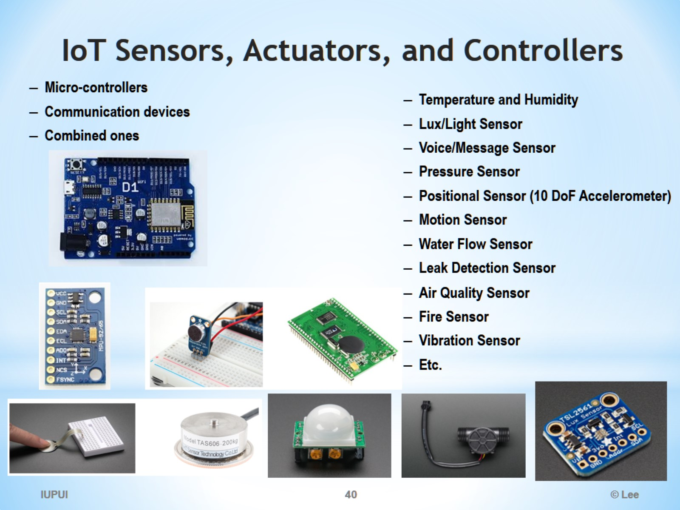
IoT Sensors, Actuators, and Controllers

Slide 41
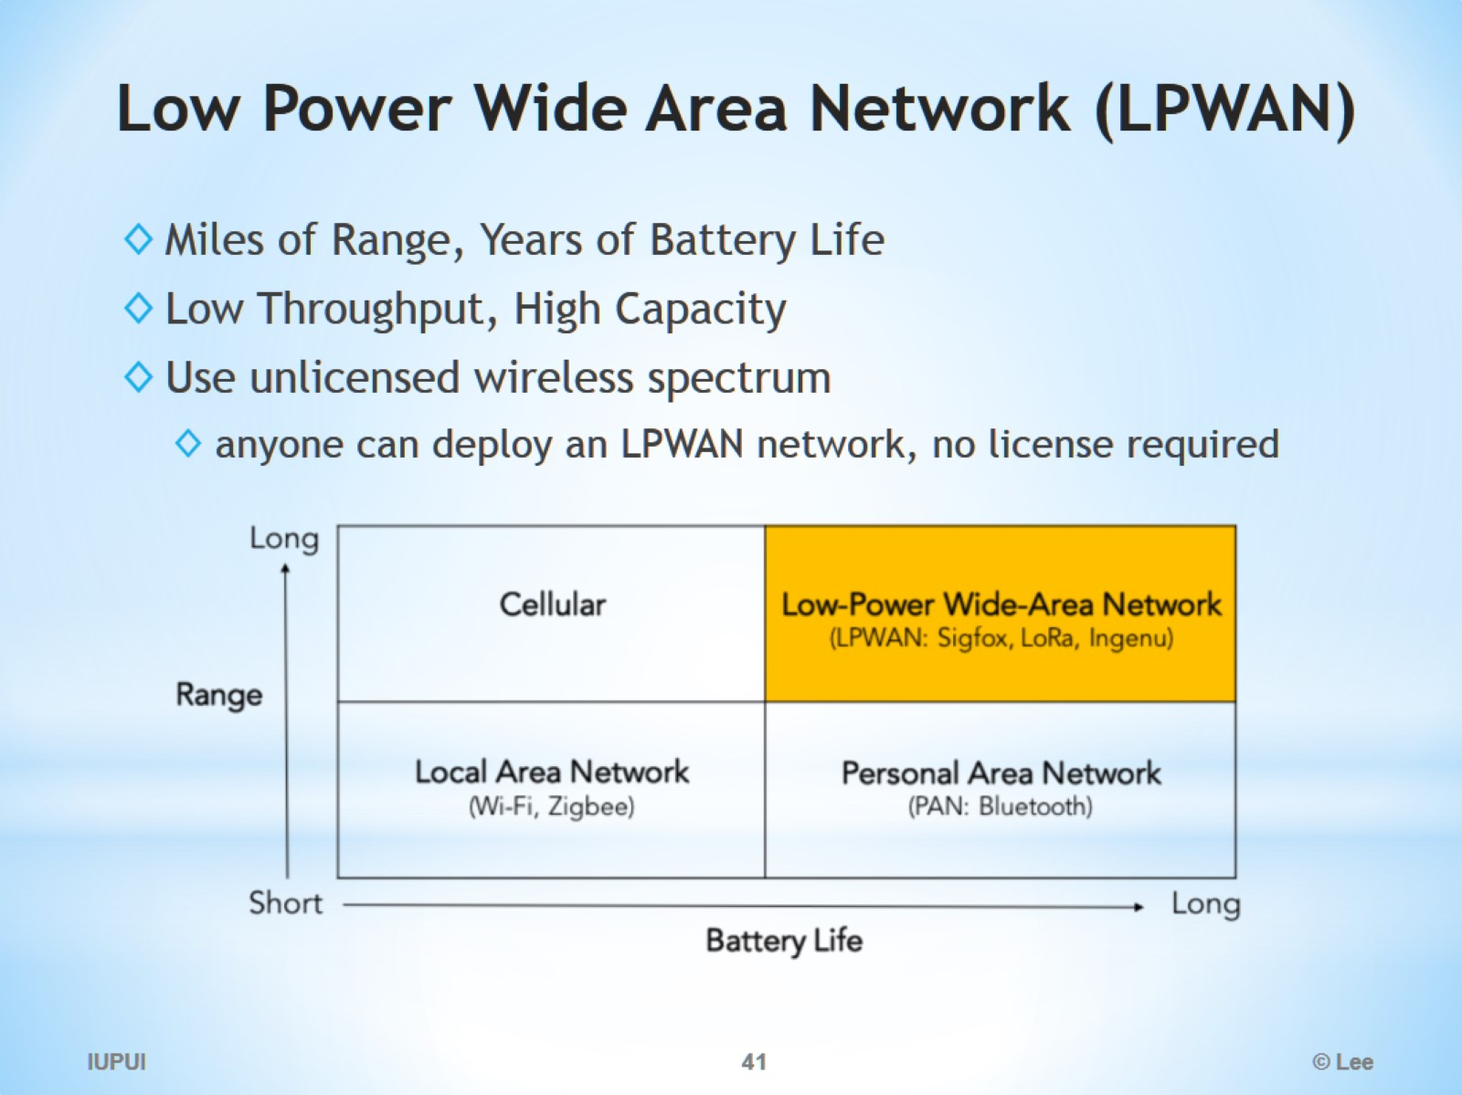
Low Power Wide Area Network (LPWAN)

Slide 42
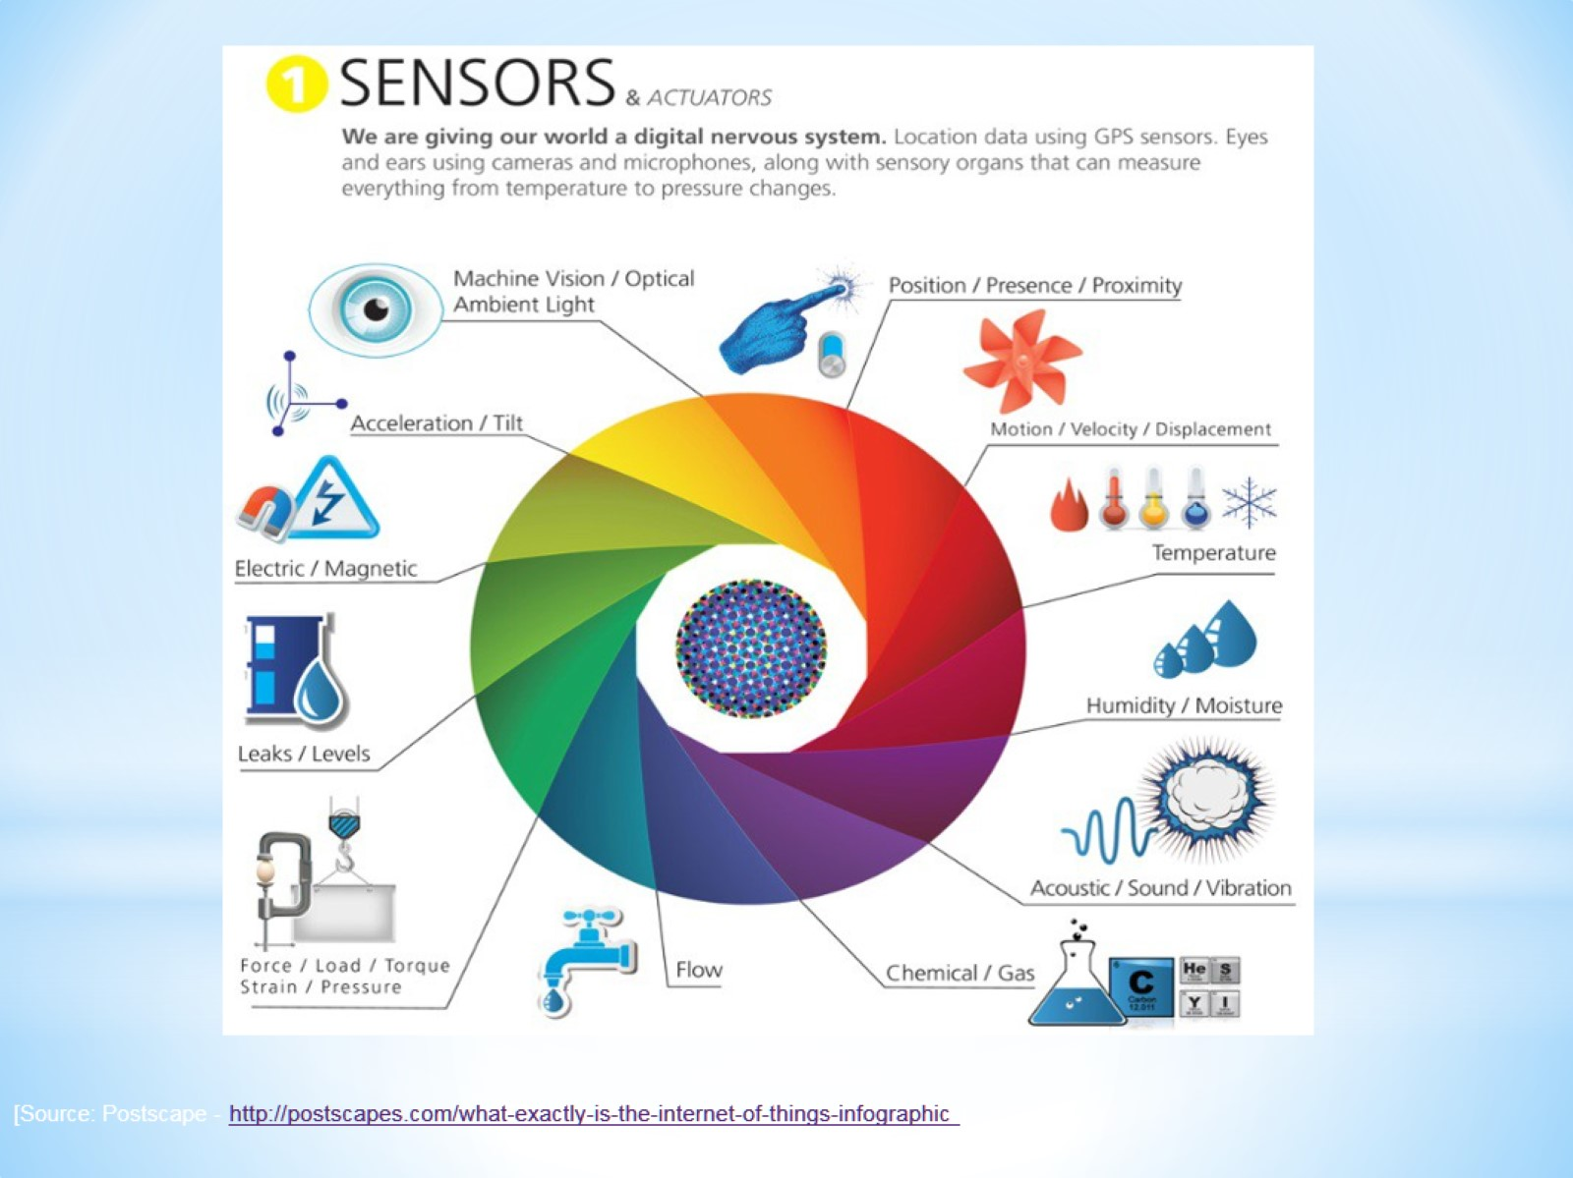

Slide 43
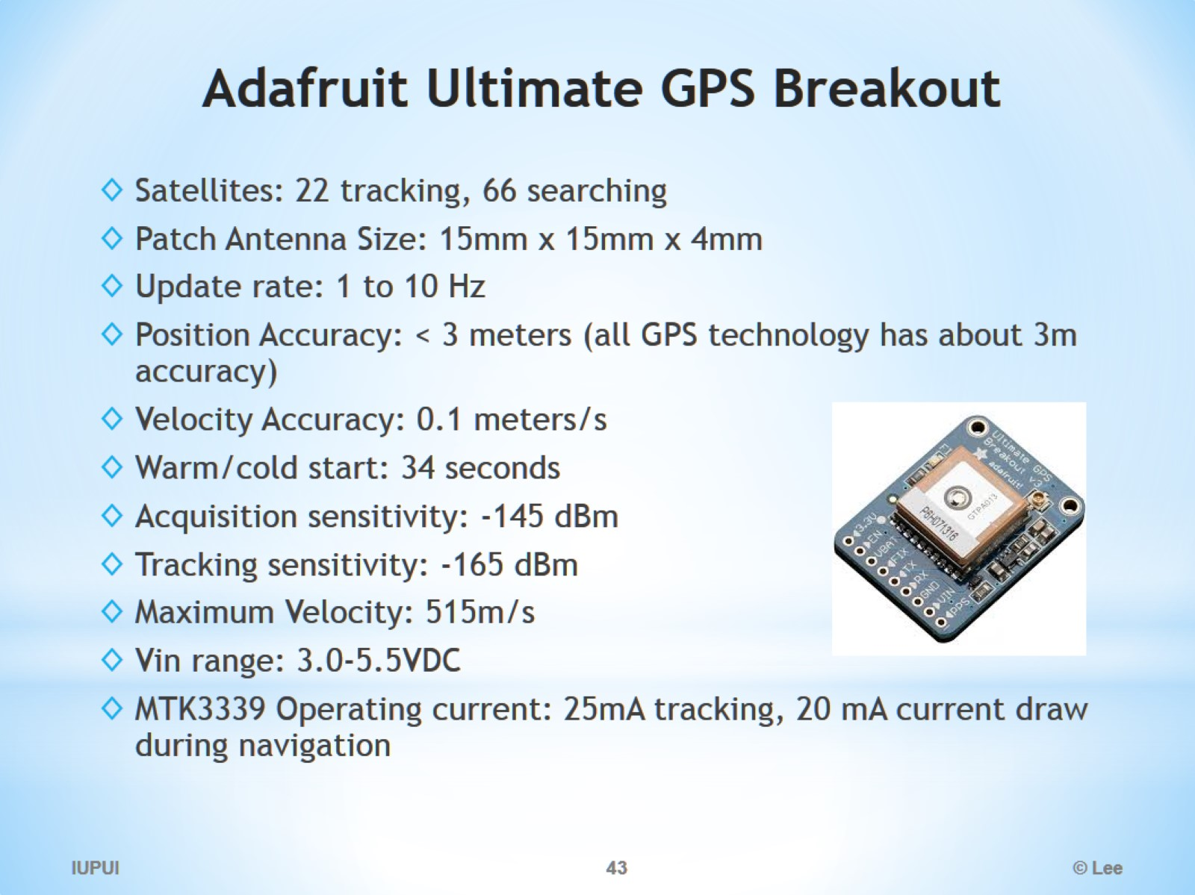
Adafruit Ultimate GPS Breakout

Slide 44
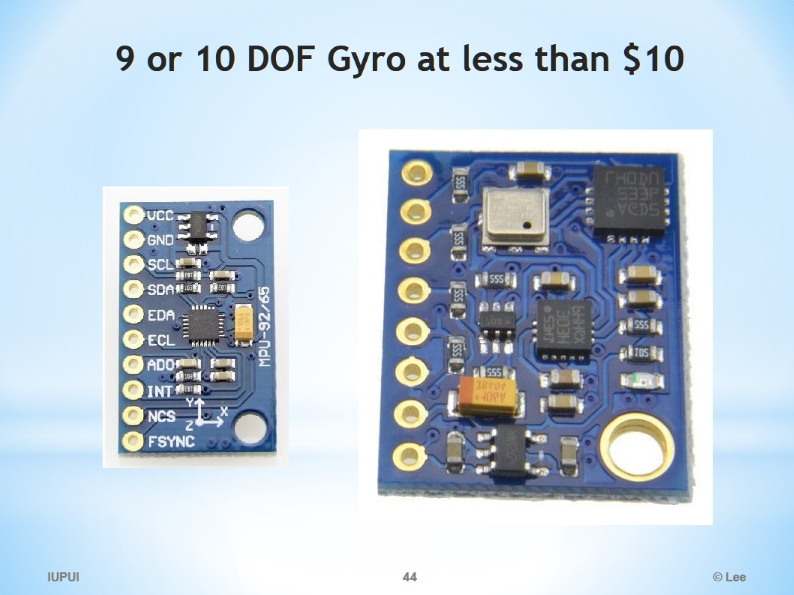
9 or 10 DOF Gyro at less than $10

Slide 45
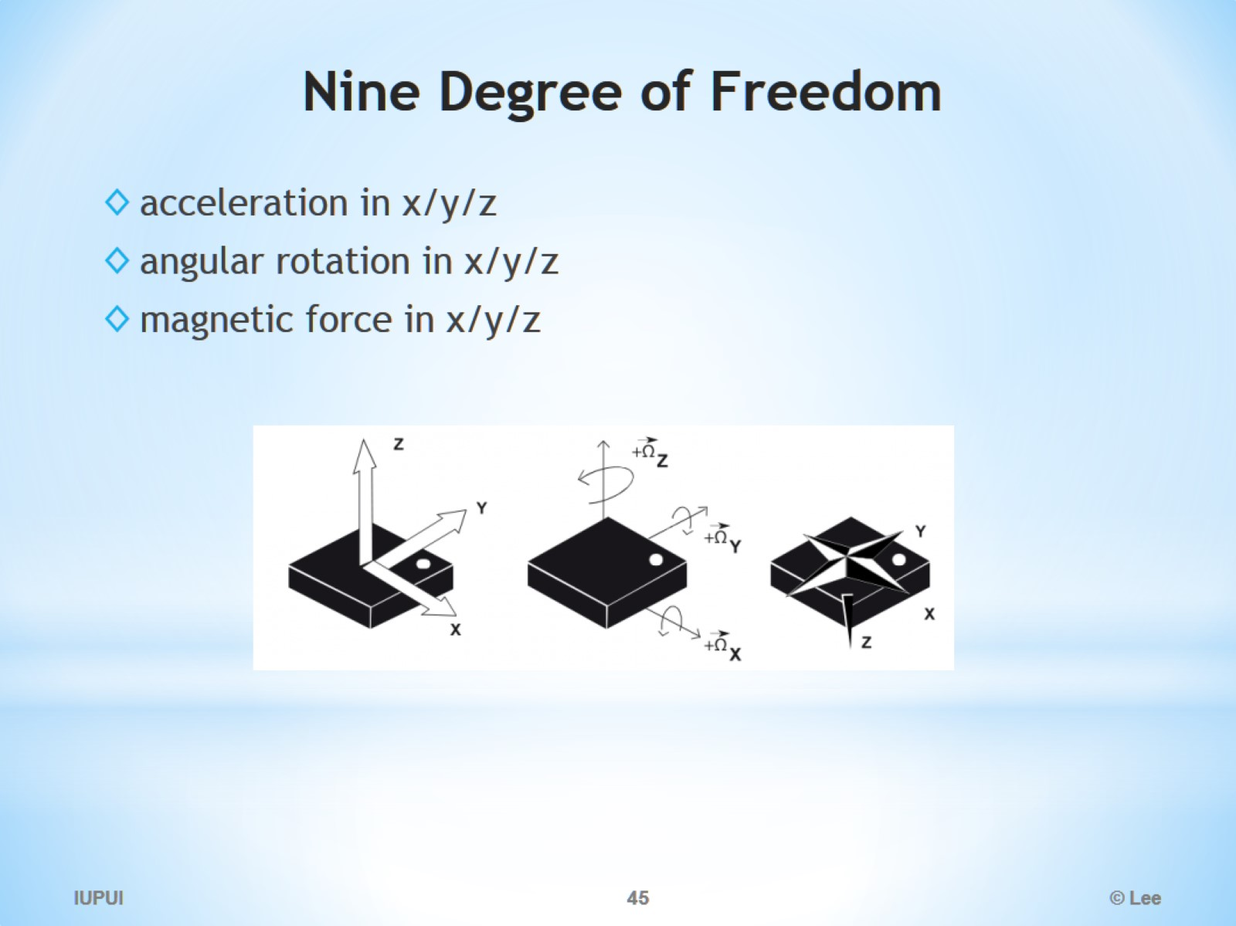
Nine Degree of Freedom

Slide 46
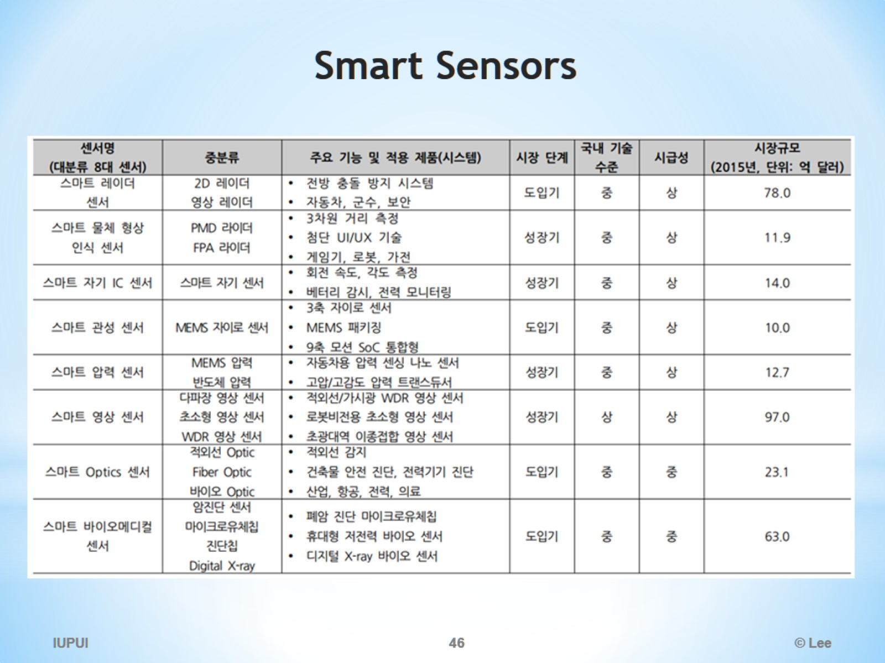
Smart Sensors

Slide 47
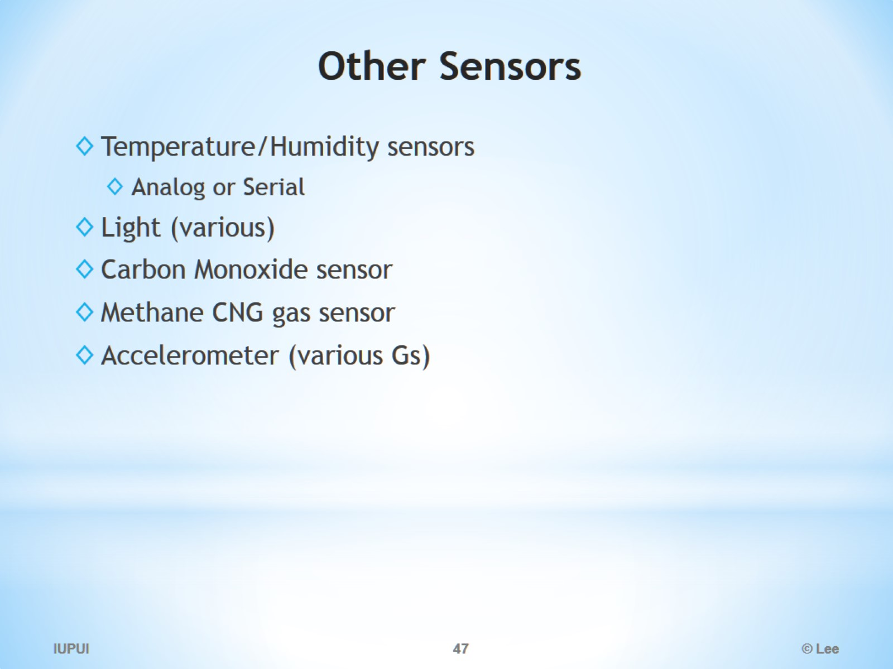
Other Sensors

Slide 48
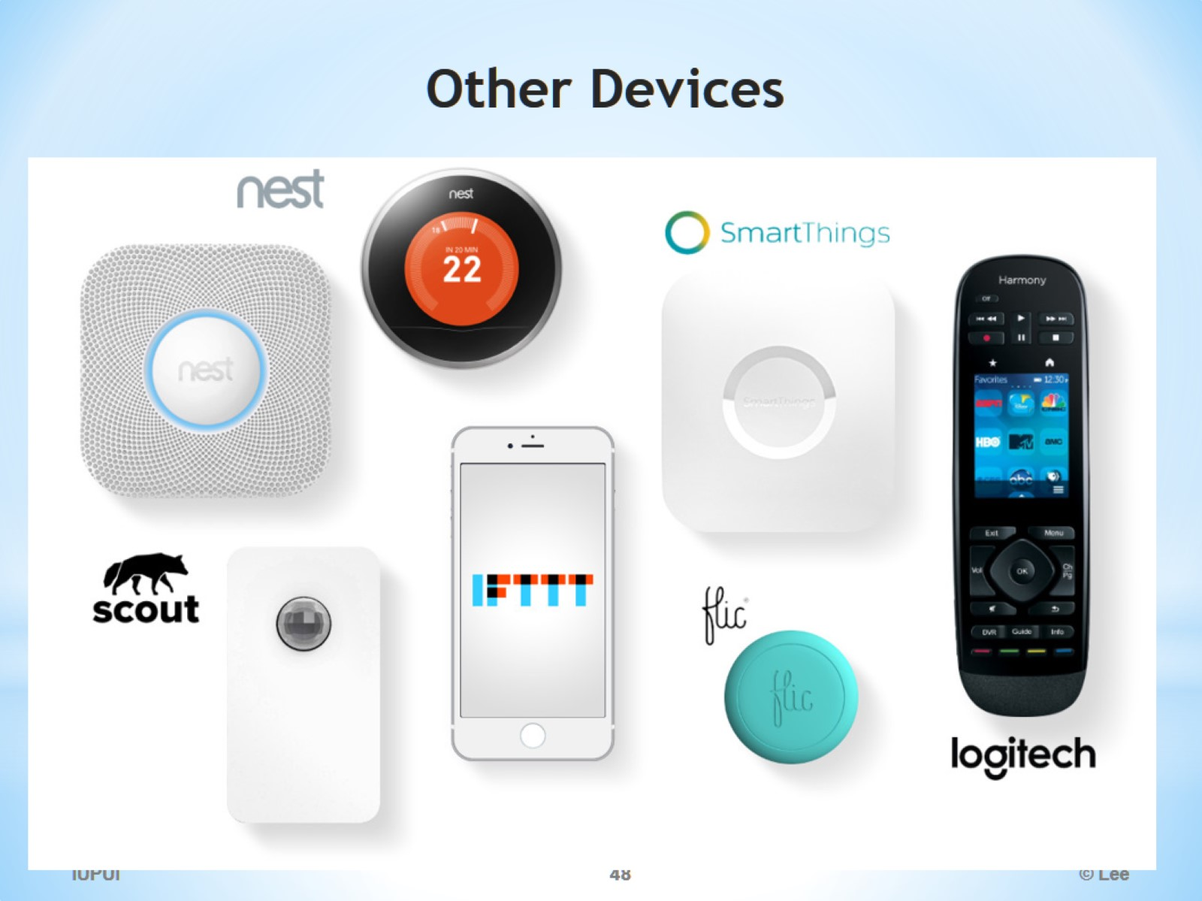
Other Devices

Slide 49
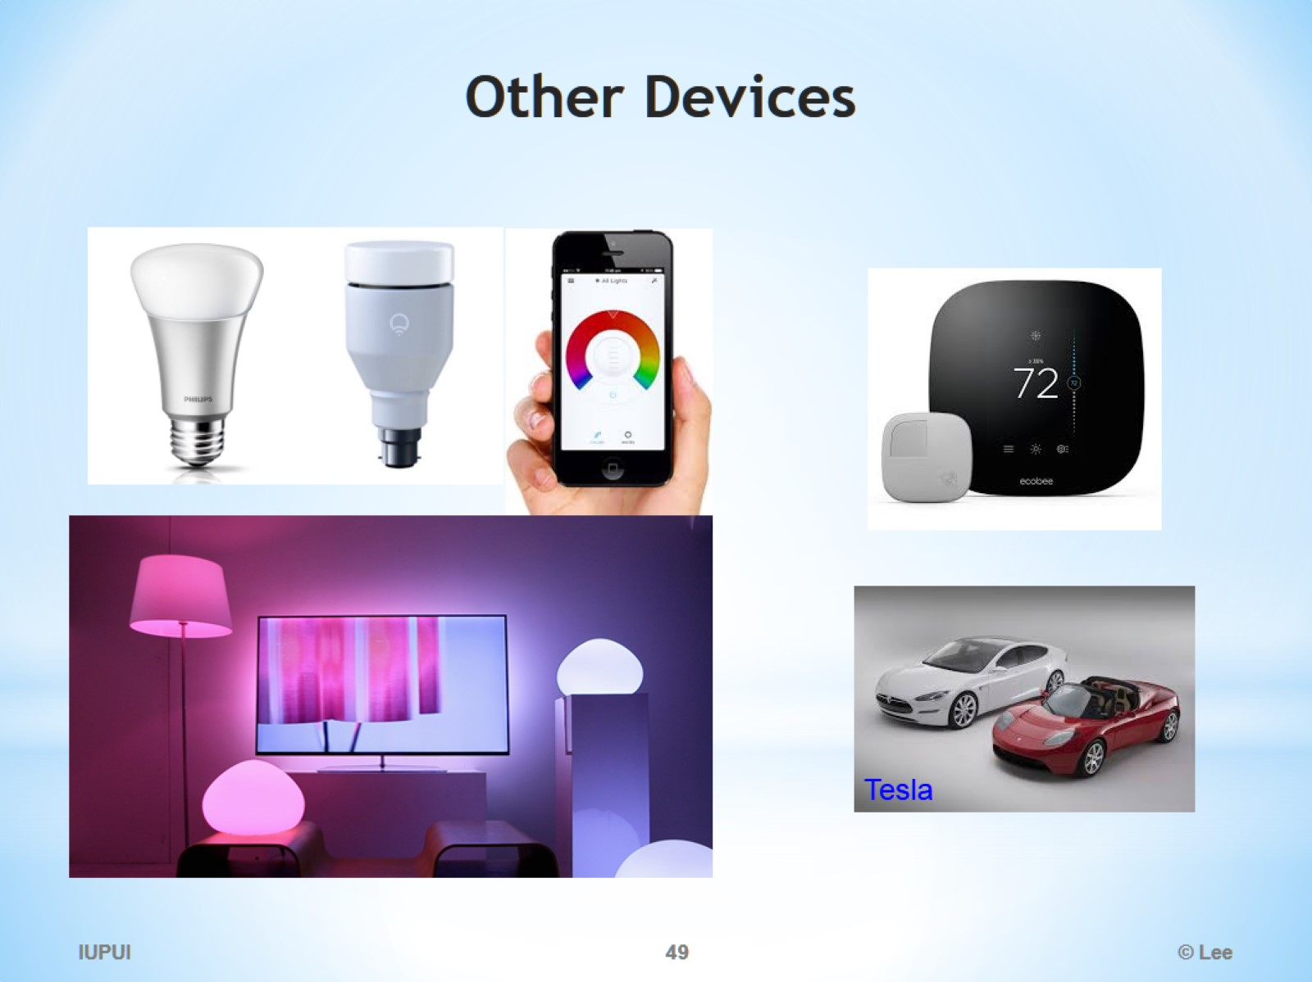
Other Devices

Slide 50
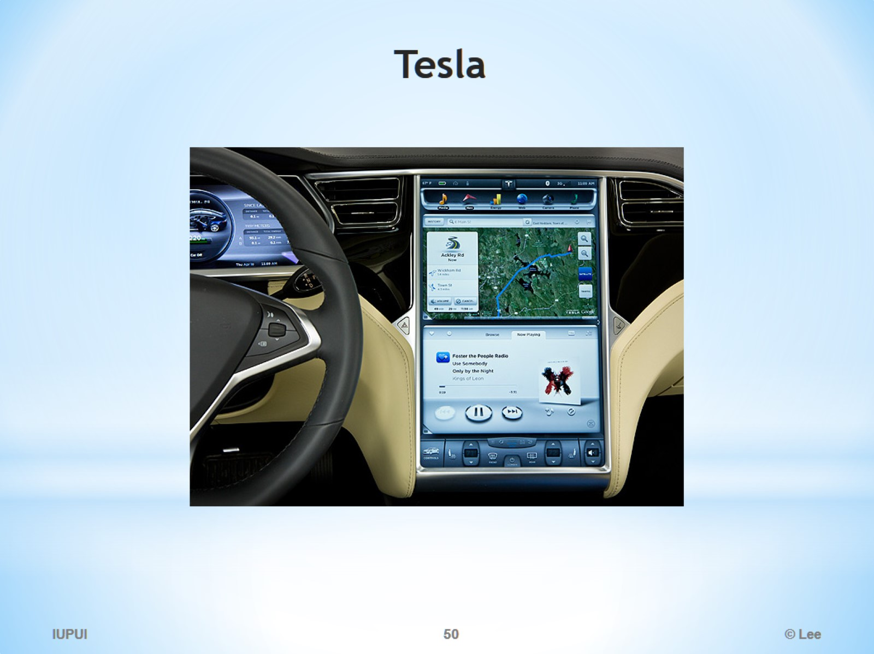
Tesla

Slide 51

Where can I buy parts and how much does it cost?

